Slide 1
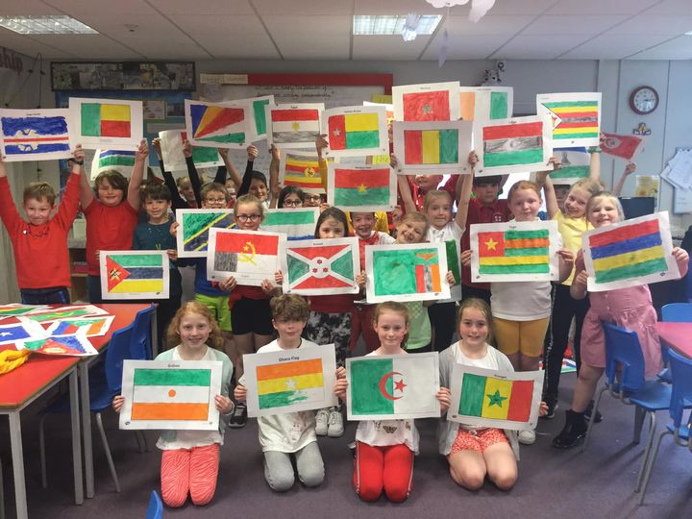
All our classes have contributed to supporting Amina, a little girl we sponsor in Togo. Here are Class 8 with their African flags and colours.

Slide 2
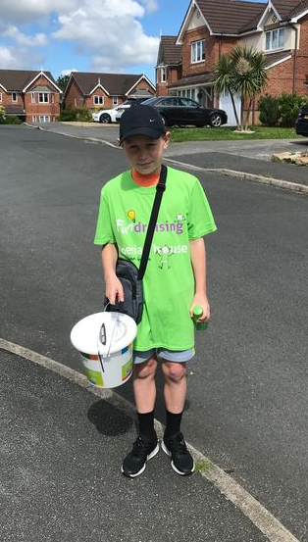
It’s always fabulous to see our pupils fundraising out of school. Here is Harry, raising money for Derian House.
April 2022

Slide 3
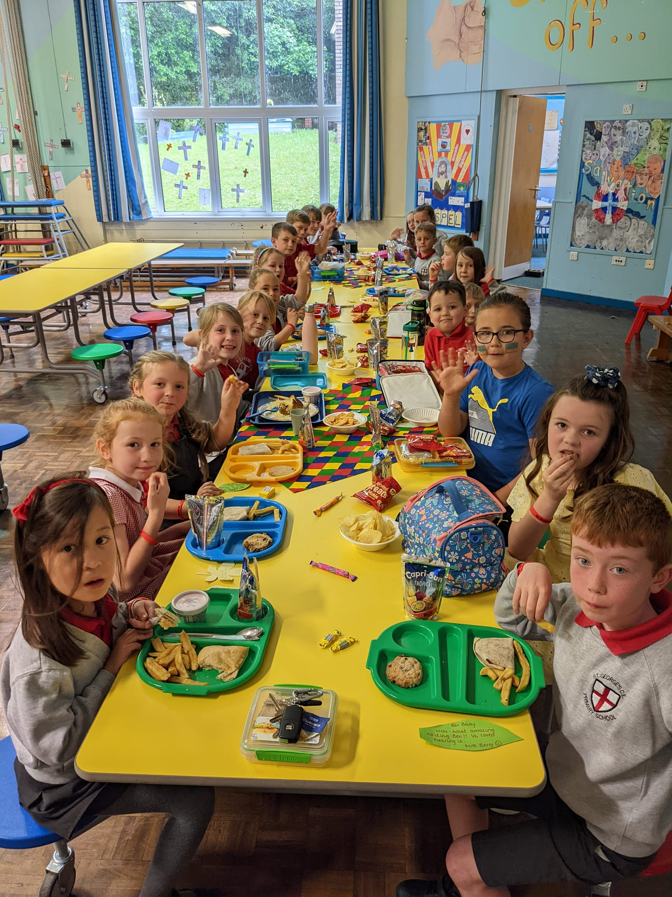
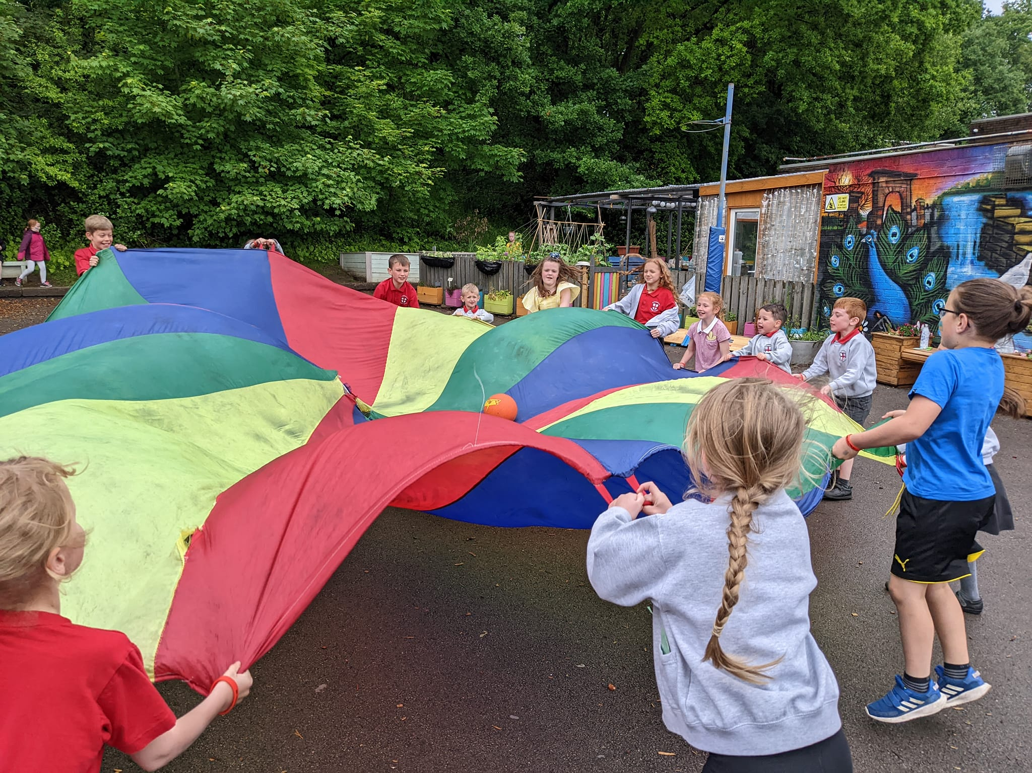
If you earn a leaf award, you may be lucky enough to win the draw and attend a leaf party!
April 2022

Slide 4
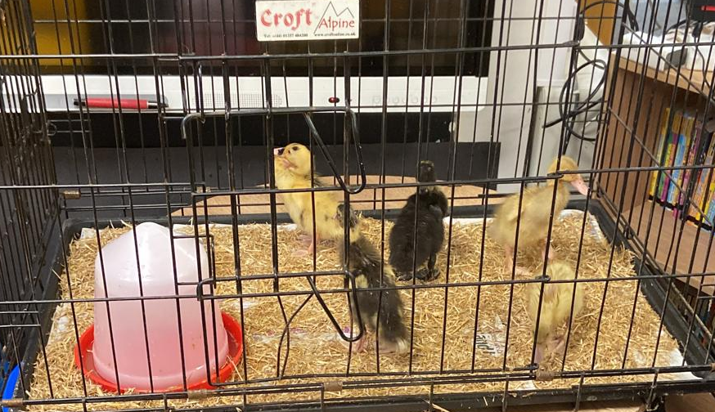
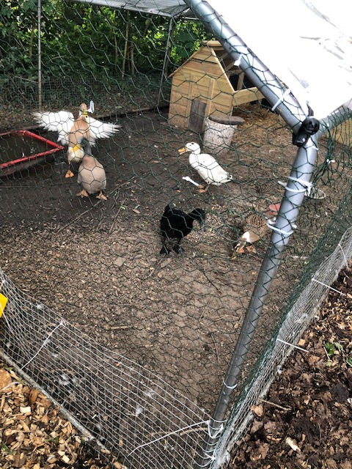
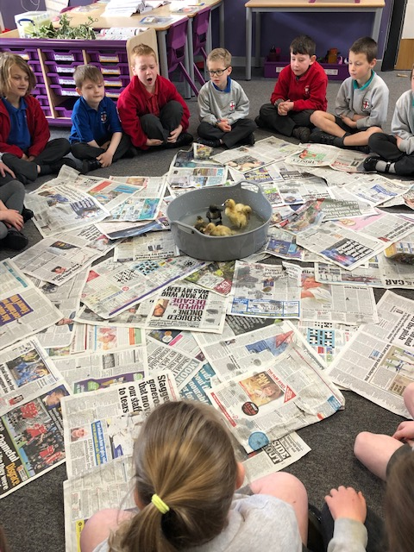
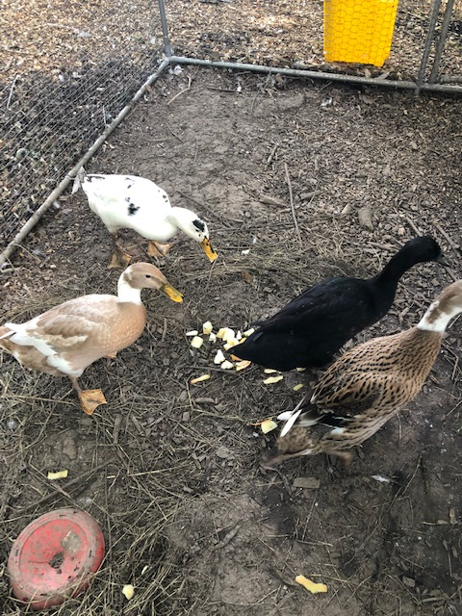
In April, we hatched five runner ducks. They now have a permanent home in our school grounds.
April 2022

Slide 5
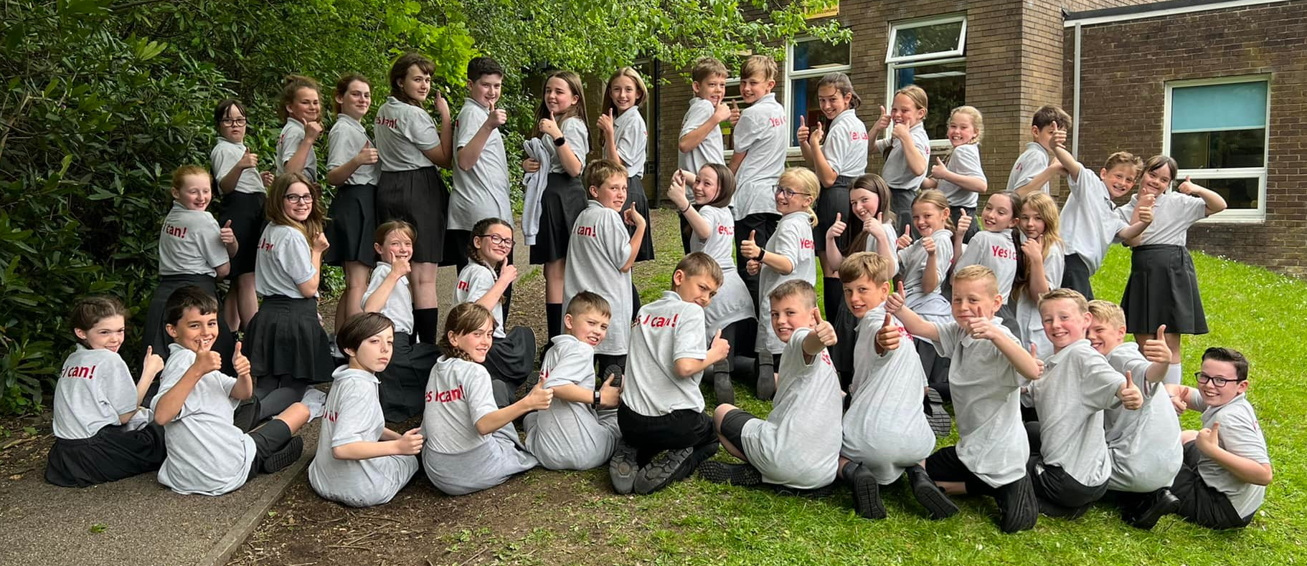
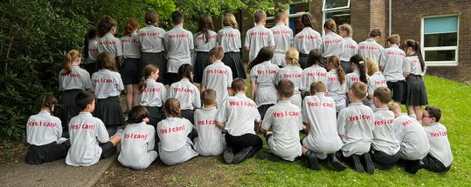
Year 6, celebrating their hard work and ready for SATs!
May 2022

Slide 6
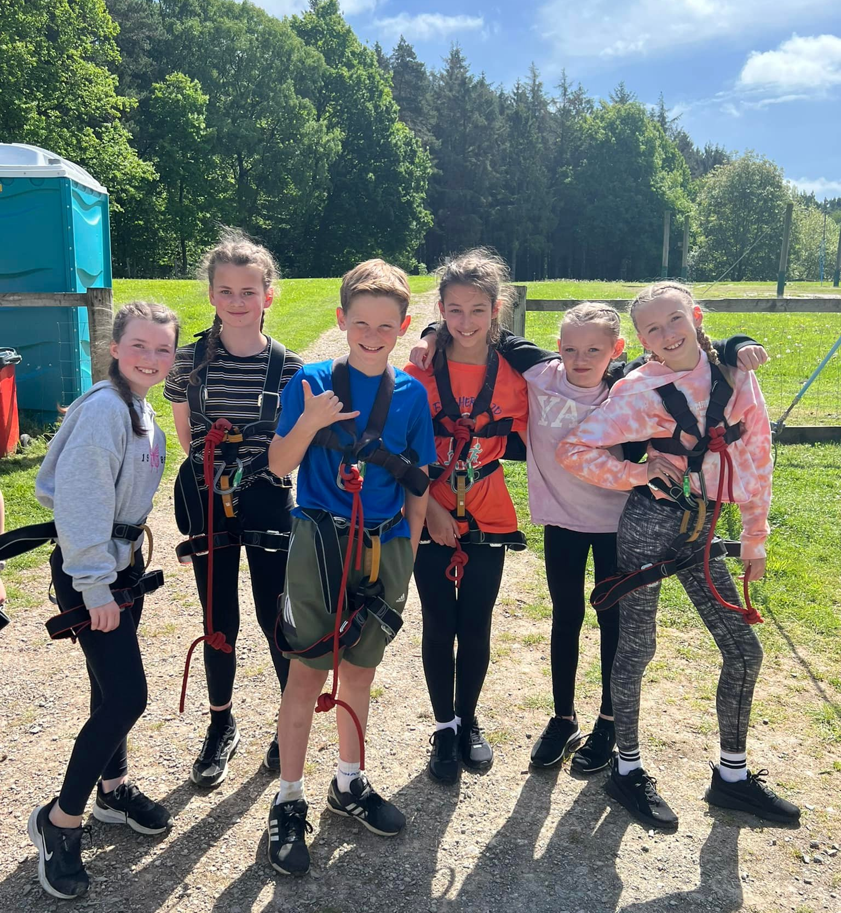
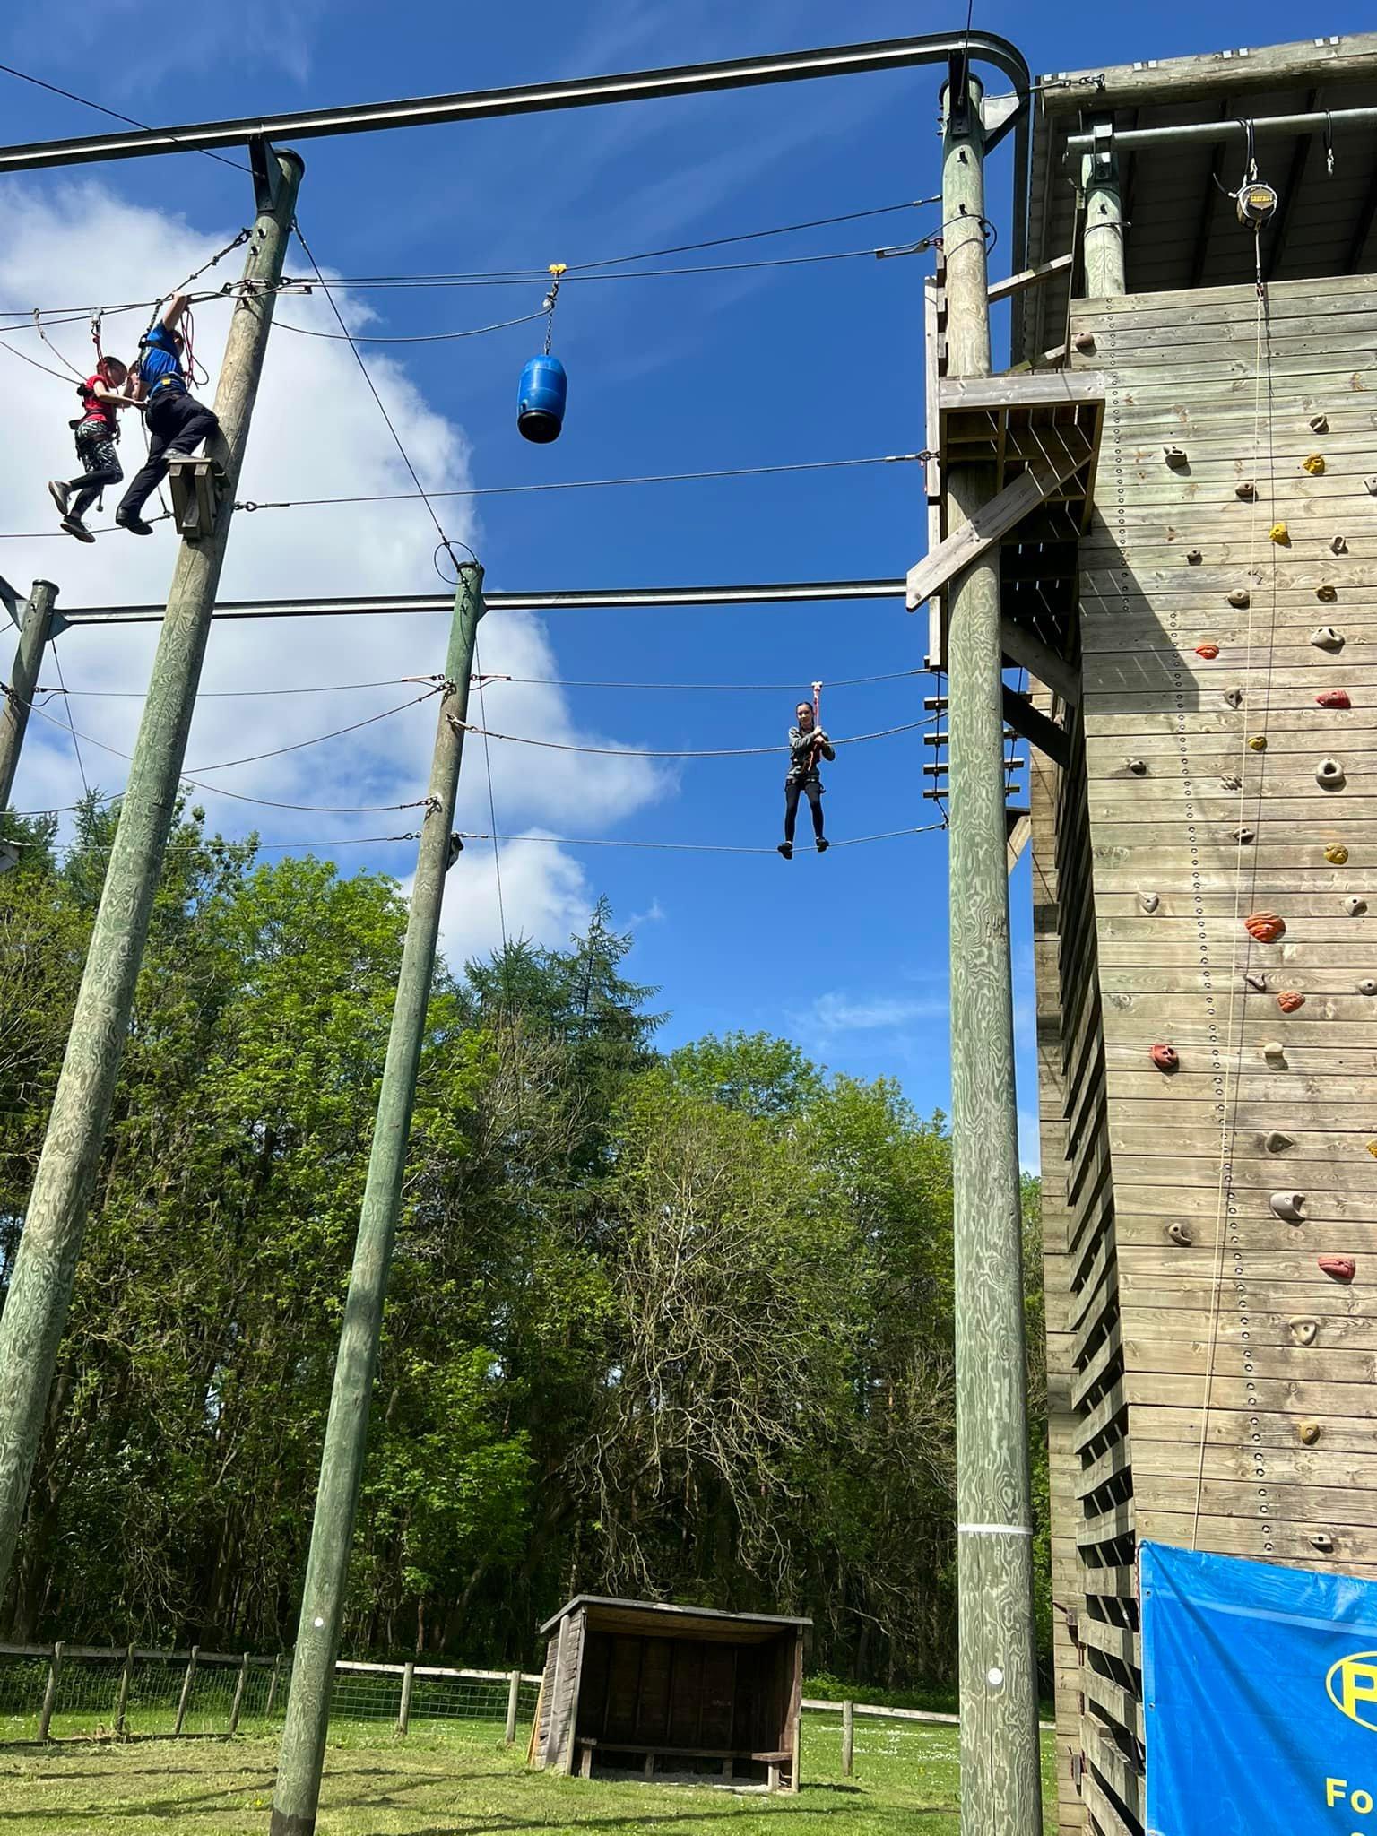
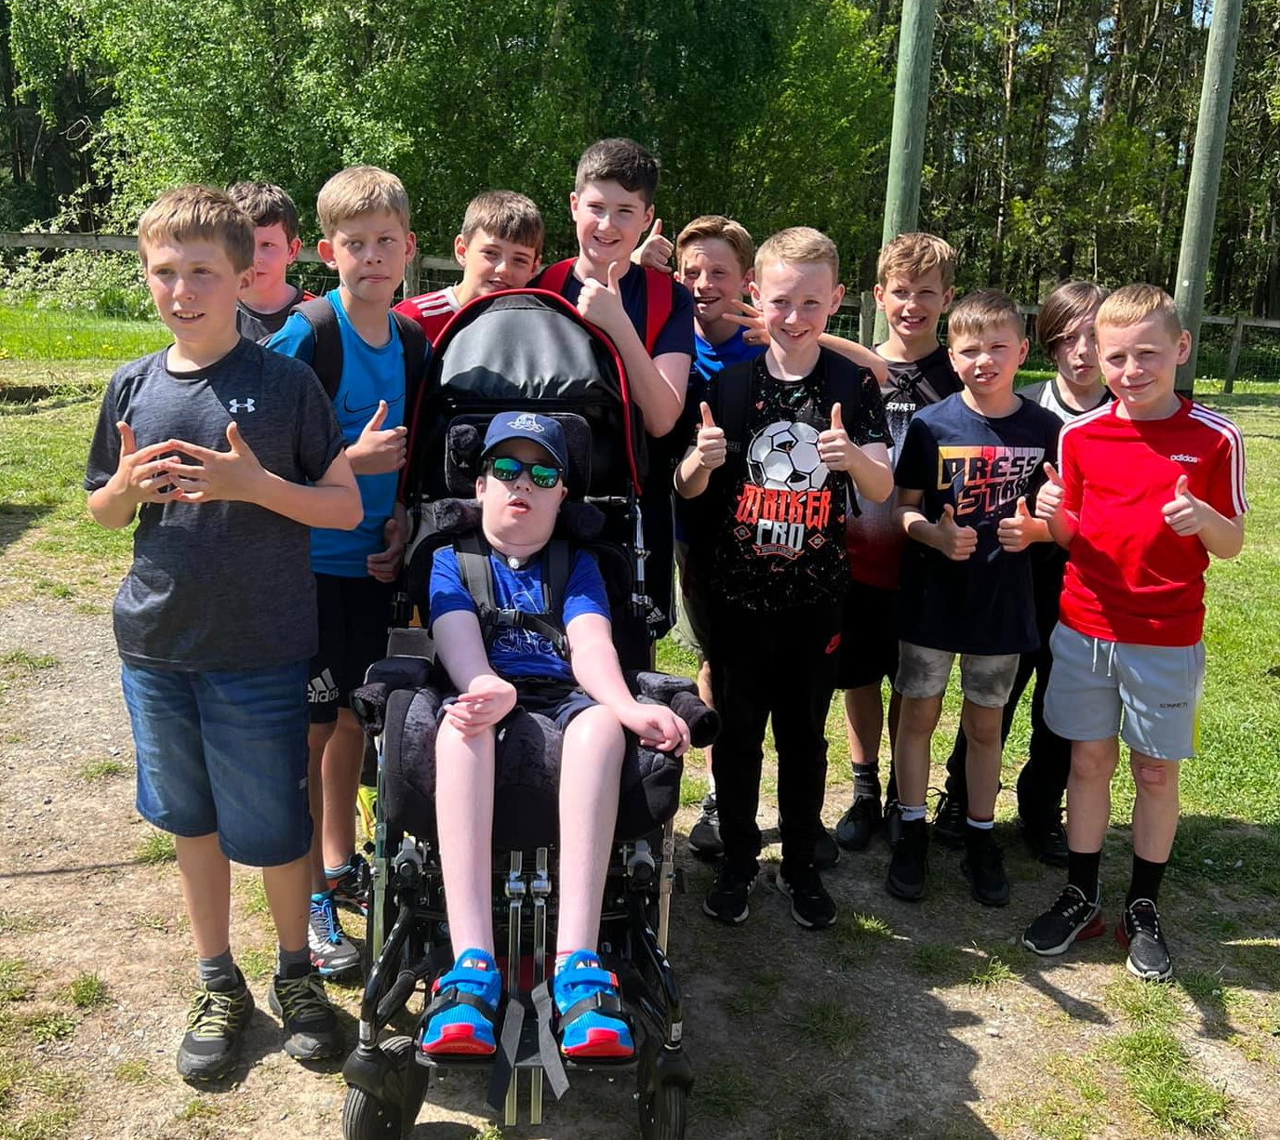
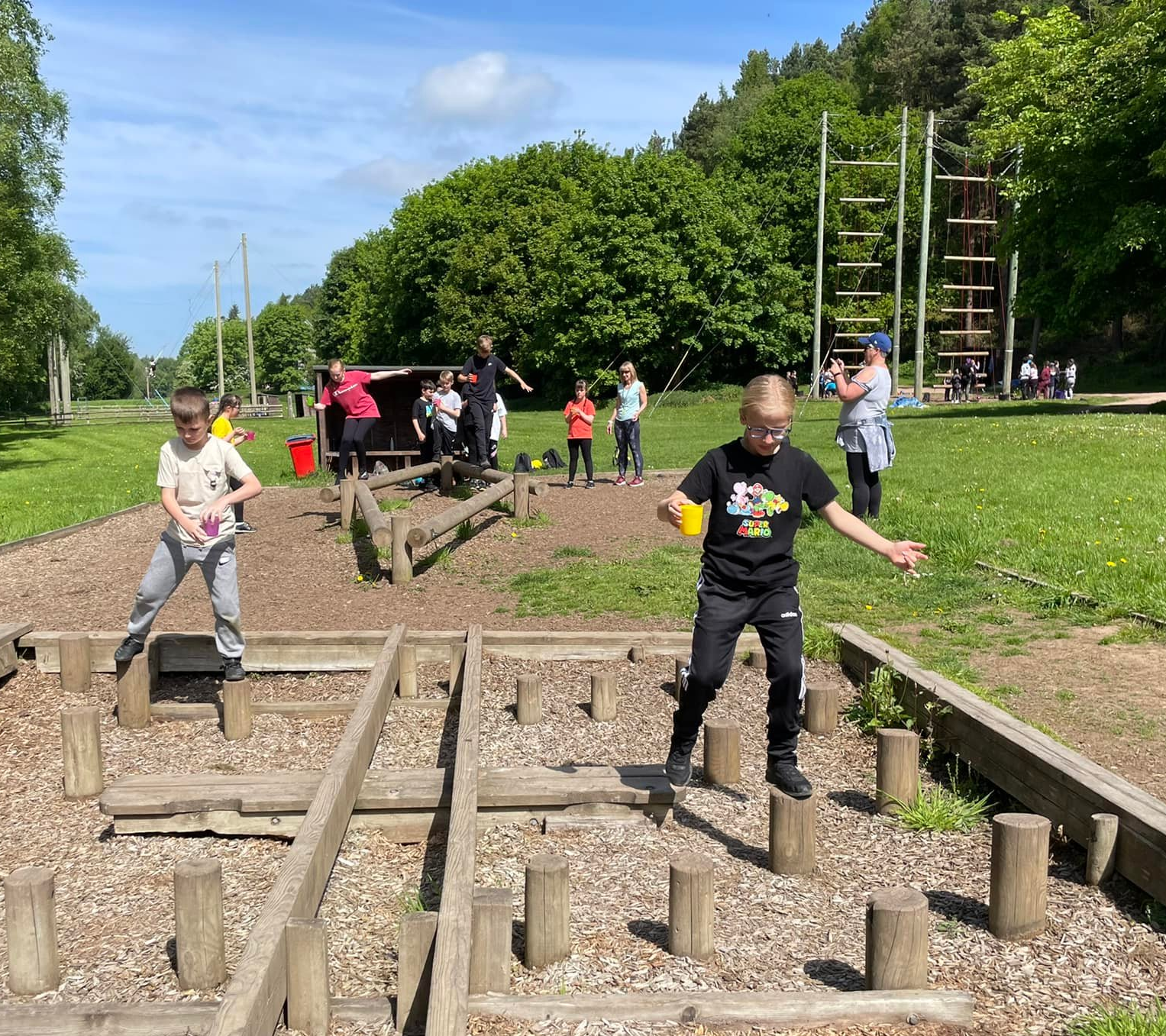
Year 6 residential, a weekend of outdoor adventurous activities and friendship.
May 2022

Slide 7
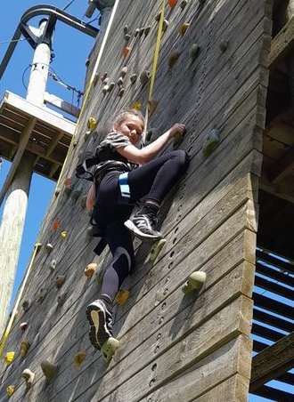
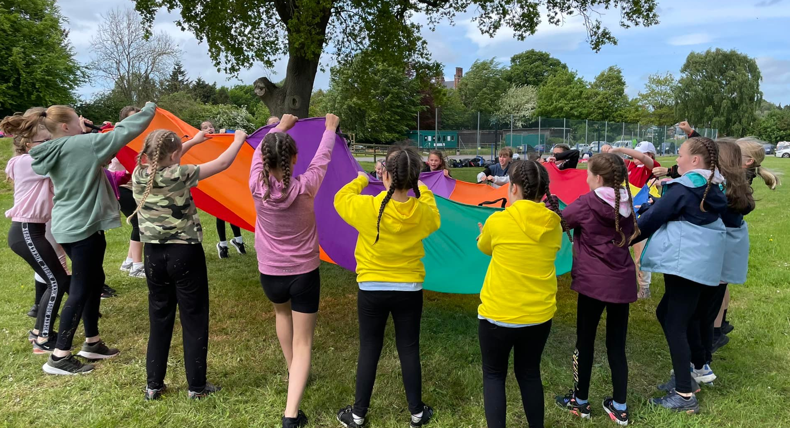
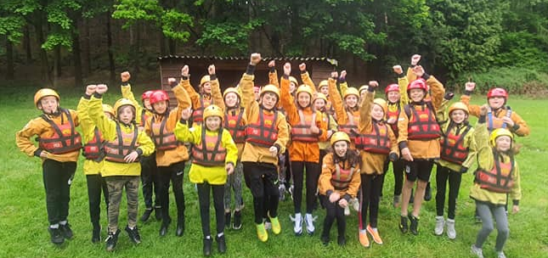
Year 6 residential, a weekend of outdoor adventurous activities and friendship.
May 2022

Slide 8
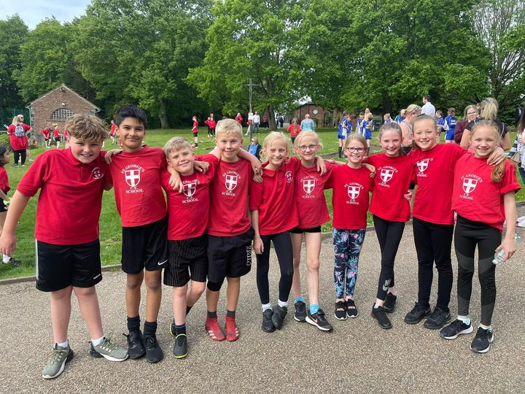
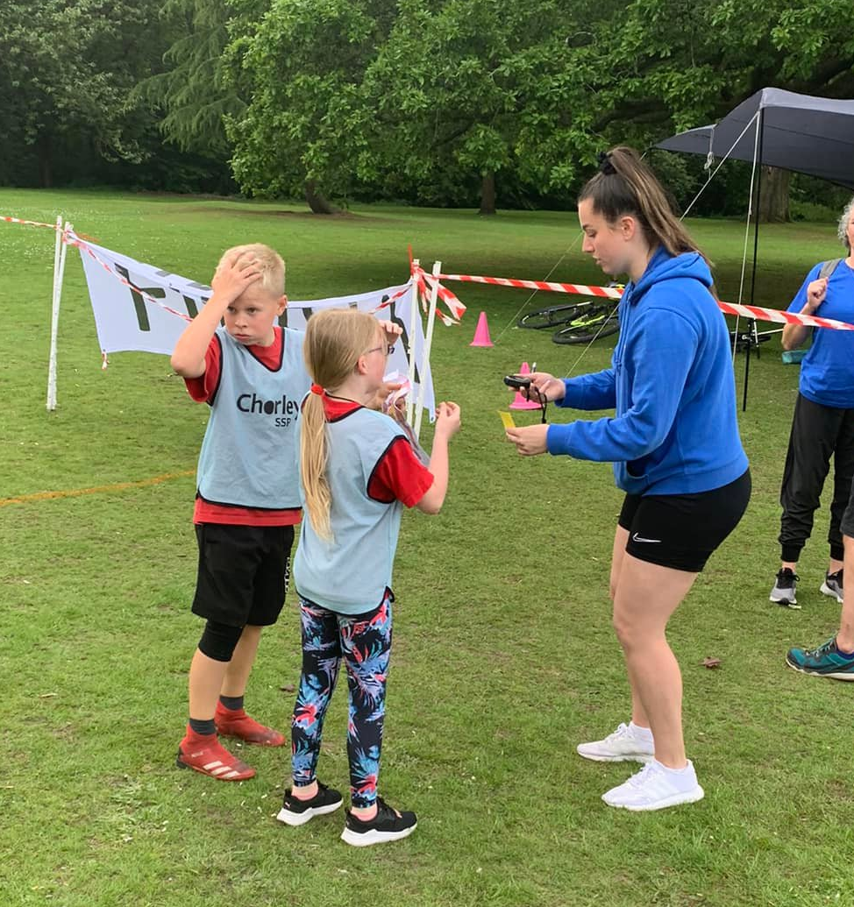
For the first time, Year 5 entered the orienteering competition in Astley Park
May 2022

Slide 9
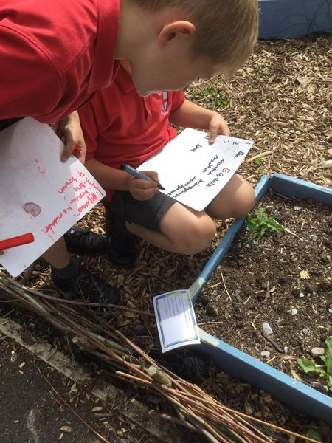
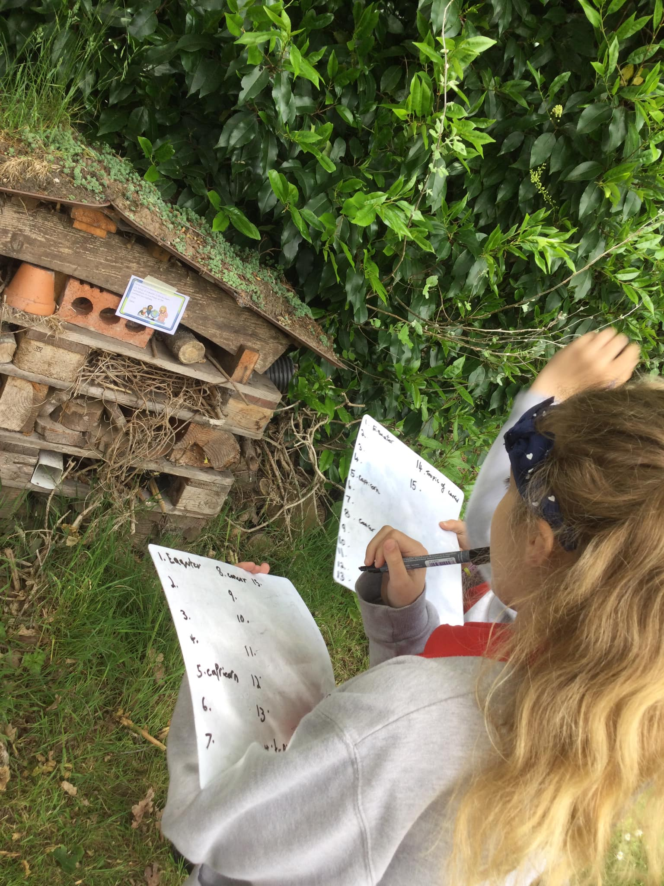
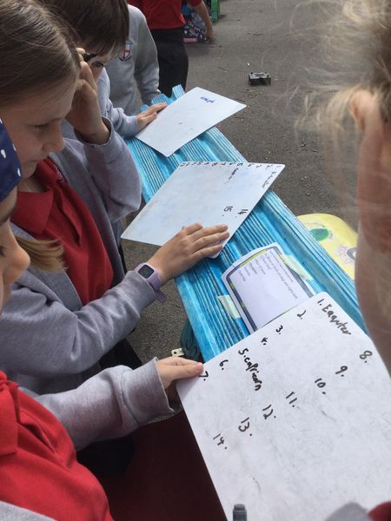
Year 5 using the school grounds for a Geography lesson.
May 2022

Slide 10
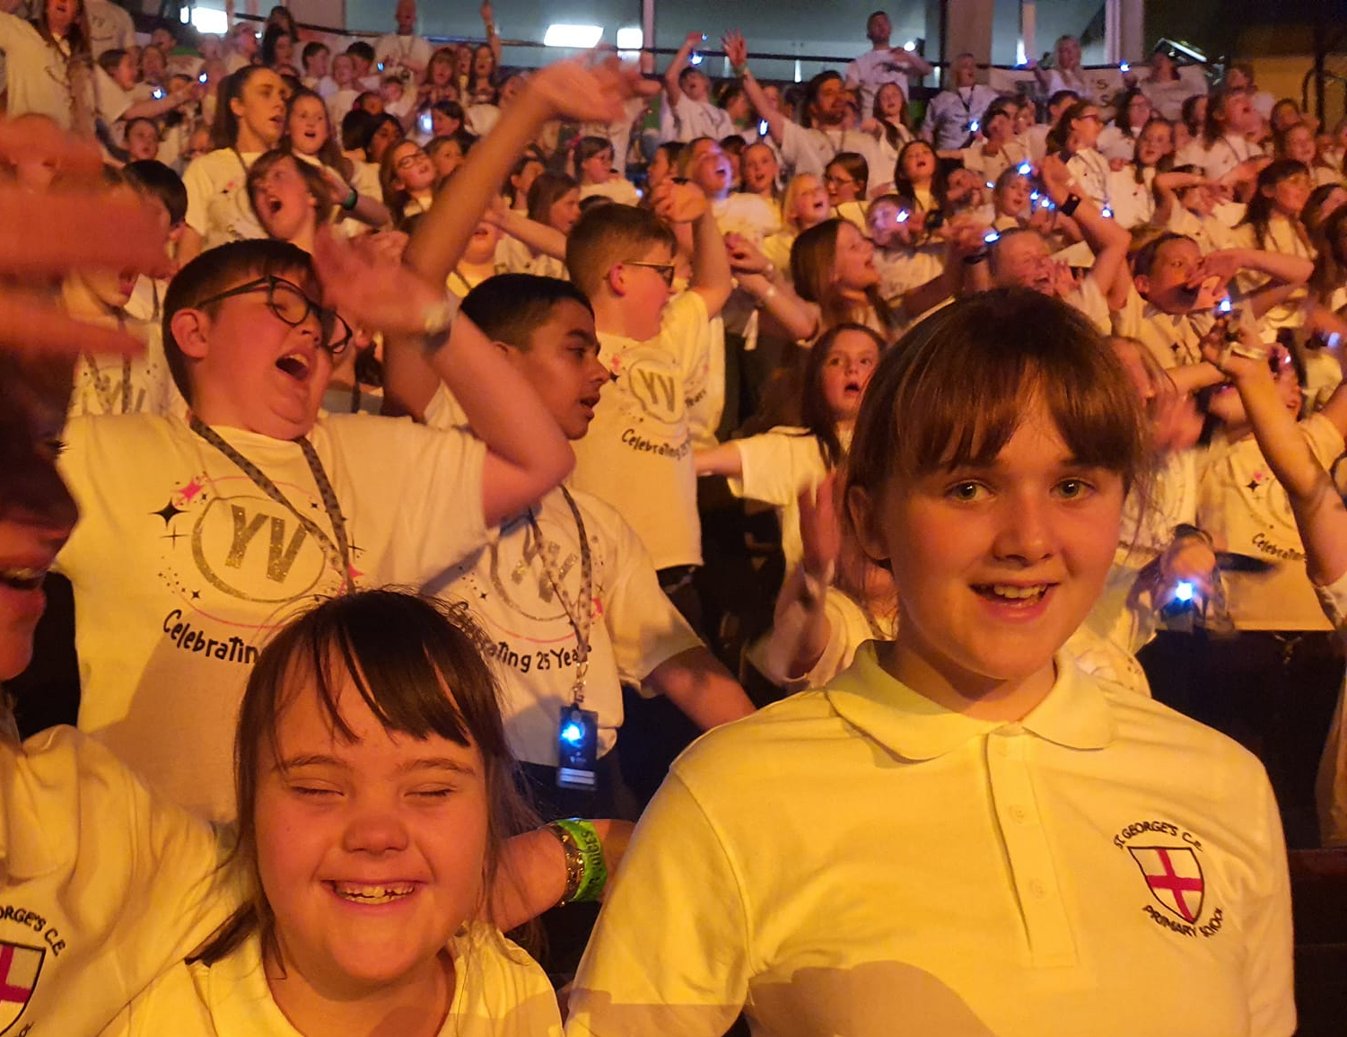
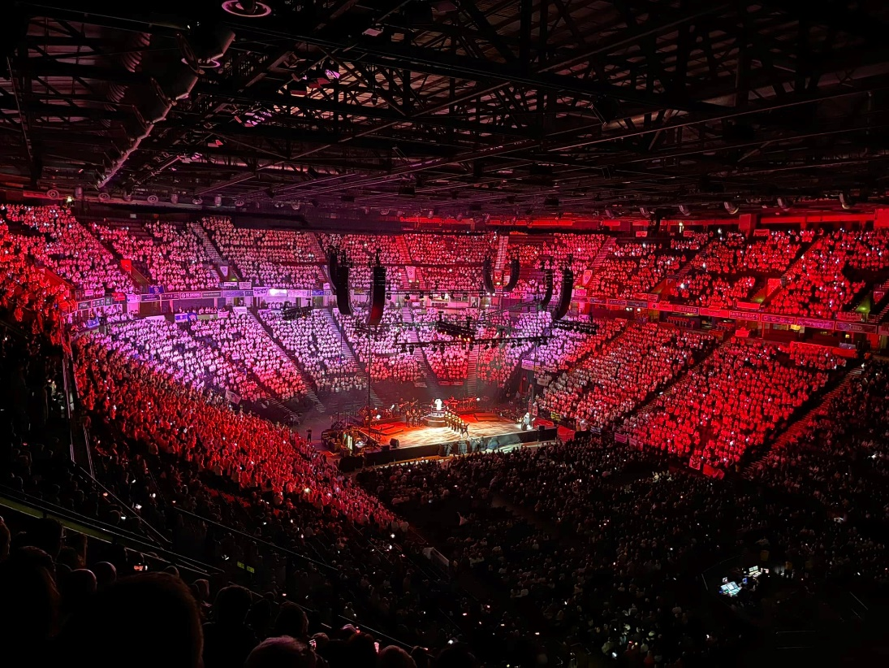
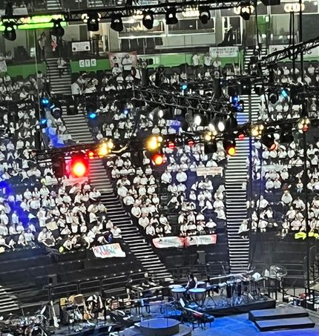
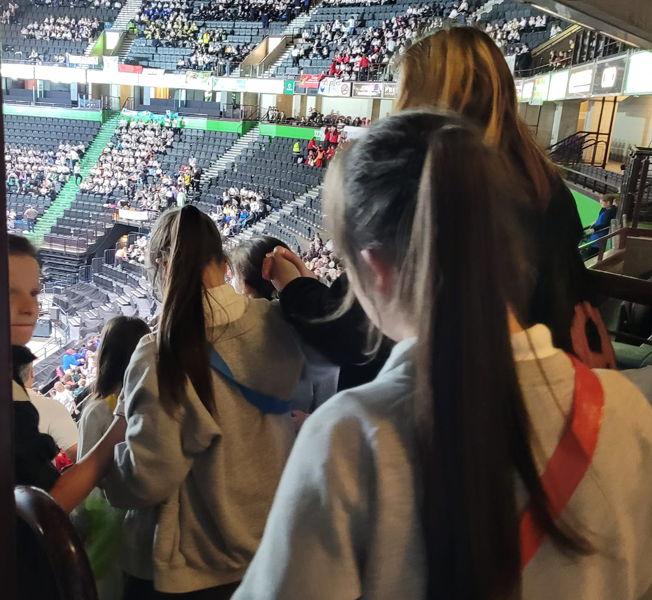
What a fabulous event-Young Voices at Manchester.
May 2022

