Slide 1
Welcome to St George’s.
We hope you enjoy these photos which will give you a snap shot of our teaching and learning beyond the classroom.
June\July 2022

Slide 2
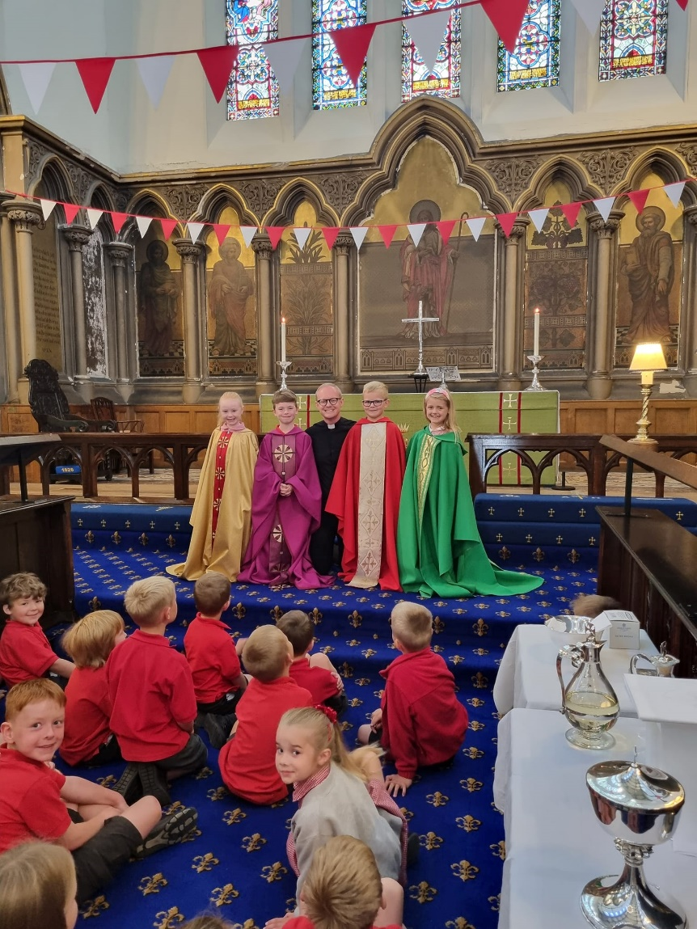
C4 at Church
All our classes visit our Church during the year. Here are Class 4 learning about different things that we see in churches before joining other parishioners at the Wednesday service.
June 2022

Slide 3
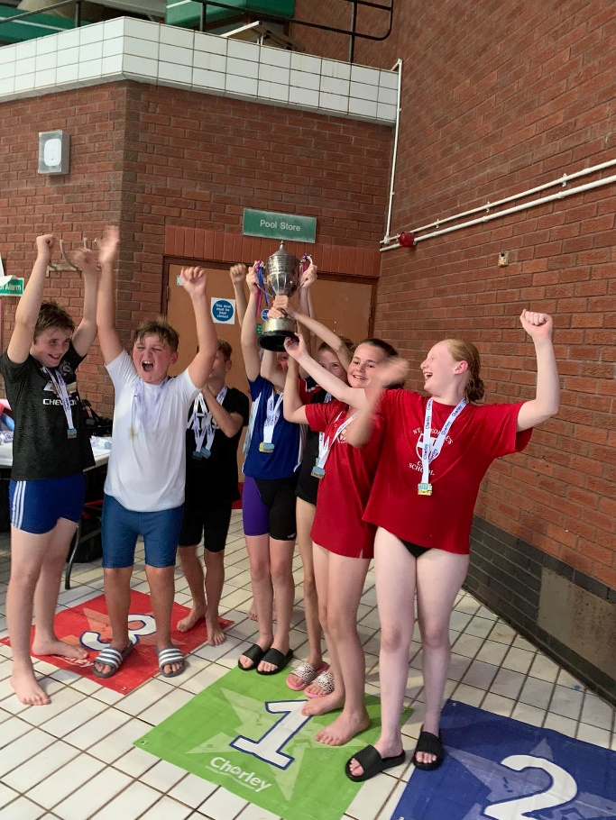
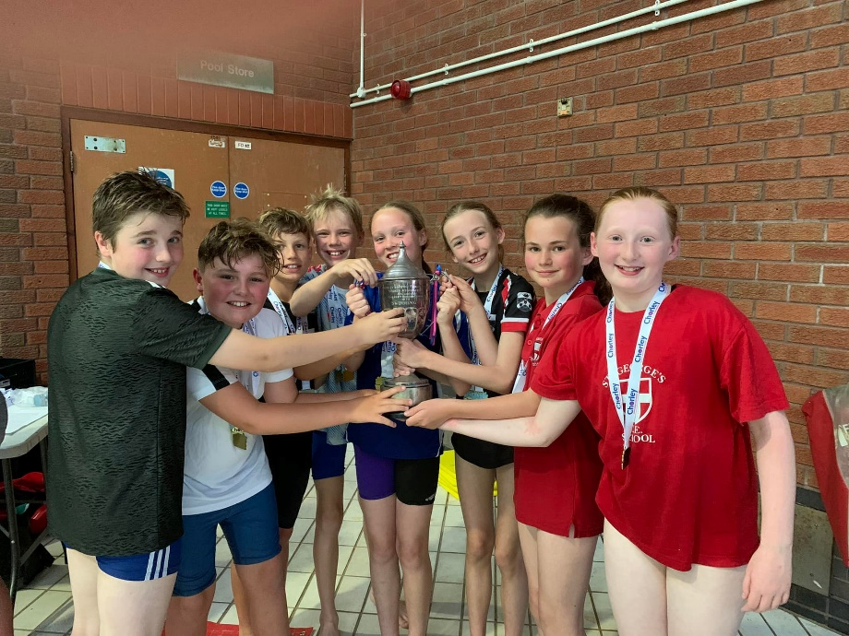
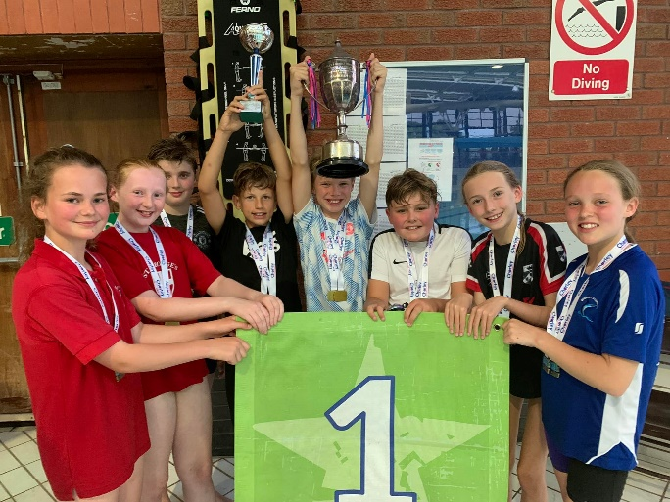
Chorley Schools Swimming Competition
Wow! St George’s only went and won the Chorley schools swimming competition!! Lots of medals but much more importantly lots of smiles and cheers of encouragement to each other and other schools.
June 2022

Slide 4
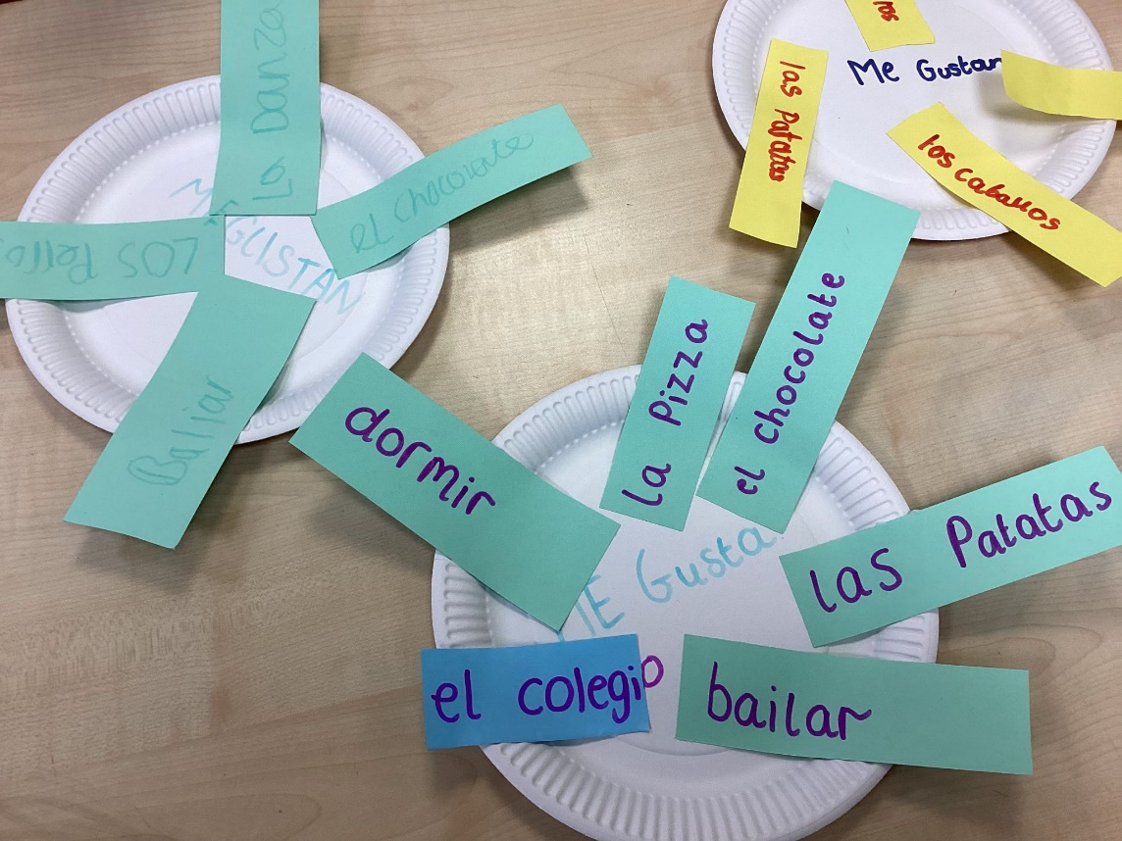
Spanish Club
Mirad qué bien!
Look at how good this is! After only a couple of weeks our Year 5 Spanish club are not only speaking and singing in Spanish, but now they are writing in Spanish too! Muy buen trabajo todos! Great work by all.
July 2022

Slide 5
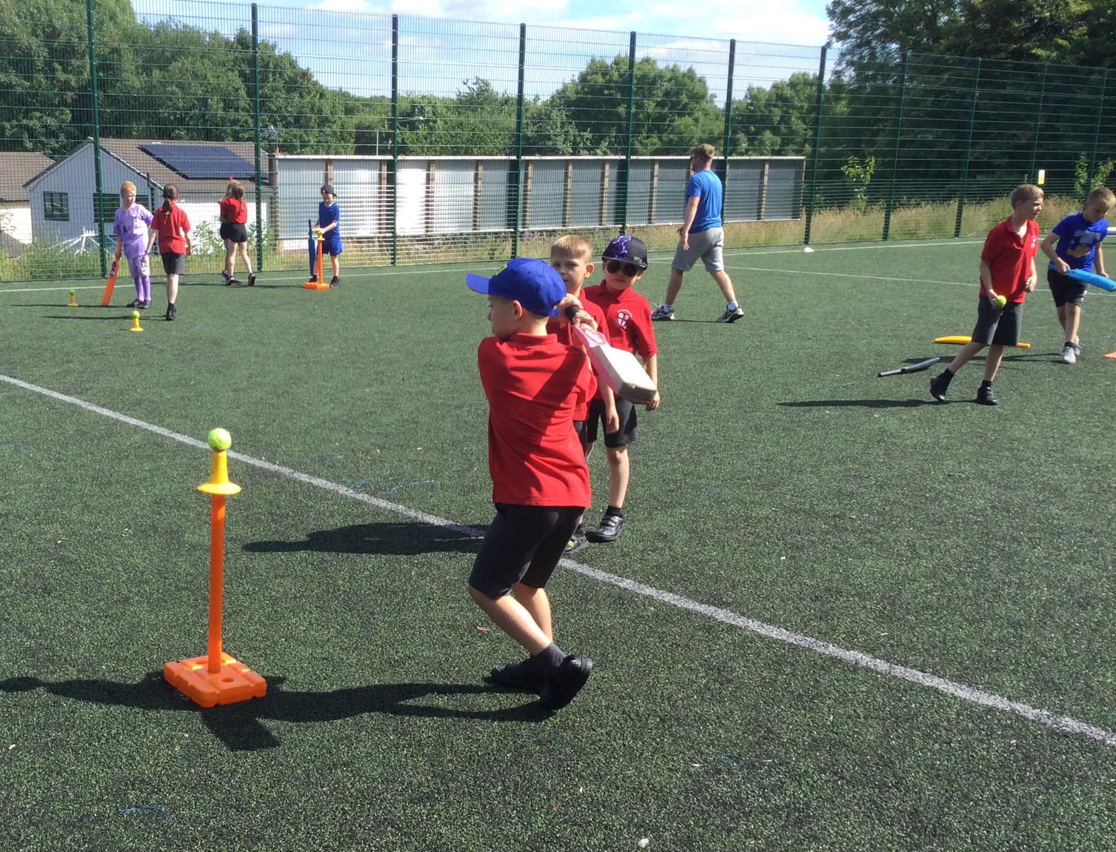
Cricket Club
We have many after school clubs at St George’s. Our cricketers are developing great skills.
June 2022

Slide 6
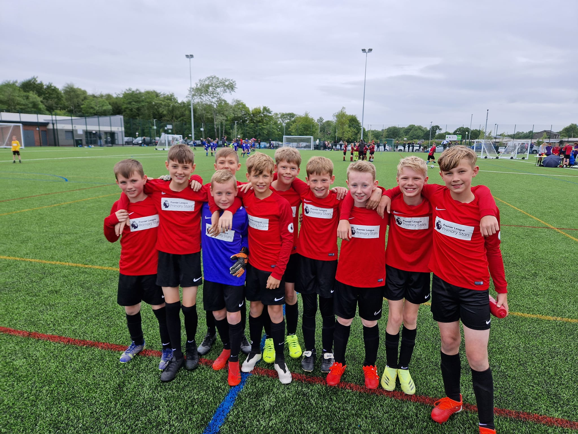
Great Sports!
We didn't make the final for Parkway's Primary School Football Tournament, but we did host the final between Balshaw Lane and St.Mary's Catholic Primary School.
July 2022

Slide 7
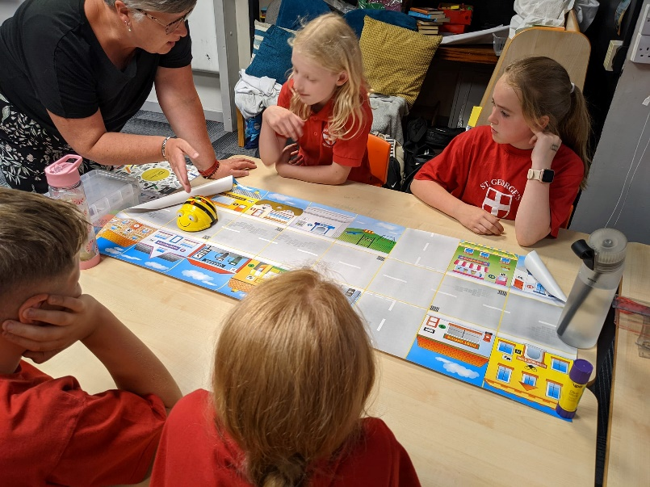
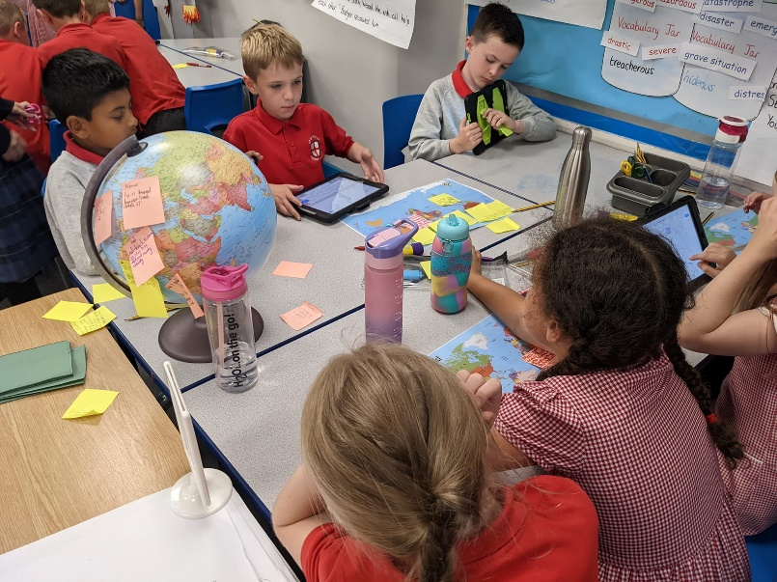
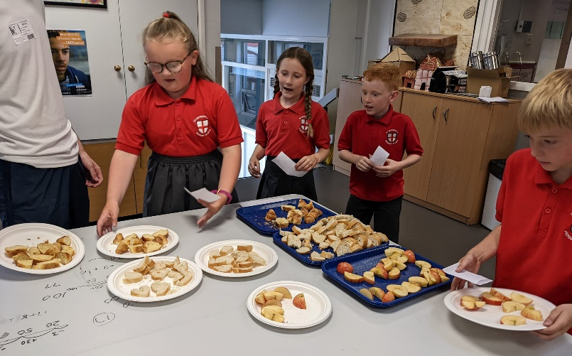
Le jour francais!
What a wonderful afternoon of French activities for KS2! They learnt about places in the world where French is spoken, played games with French colours, directed a French robot and served in a French café! Thank you to Albany high school who sent over some experts.
July 2022

Slide 8
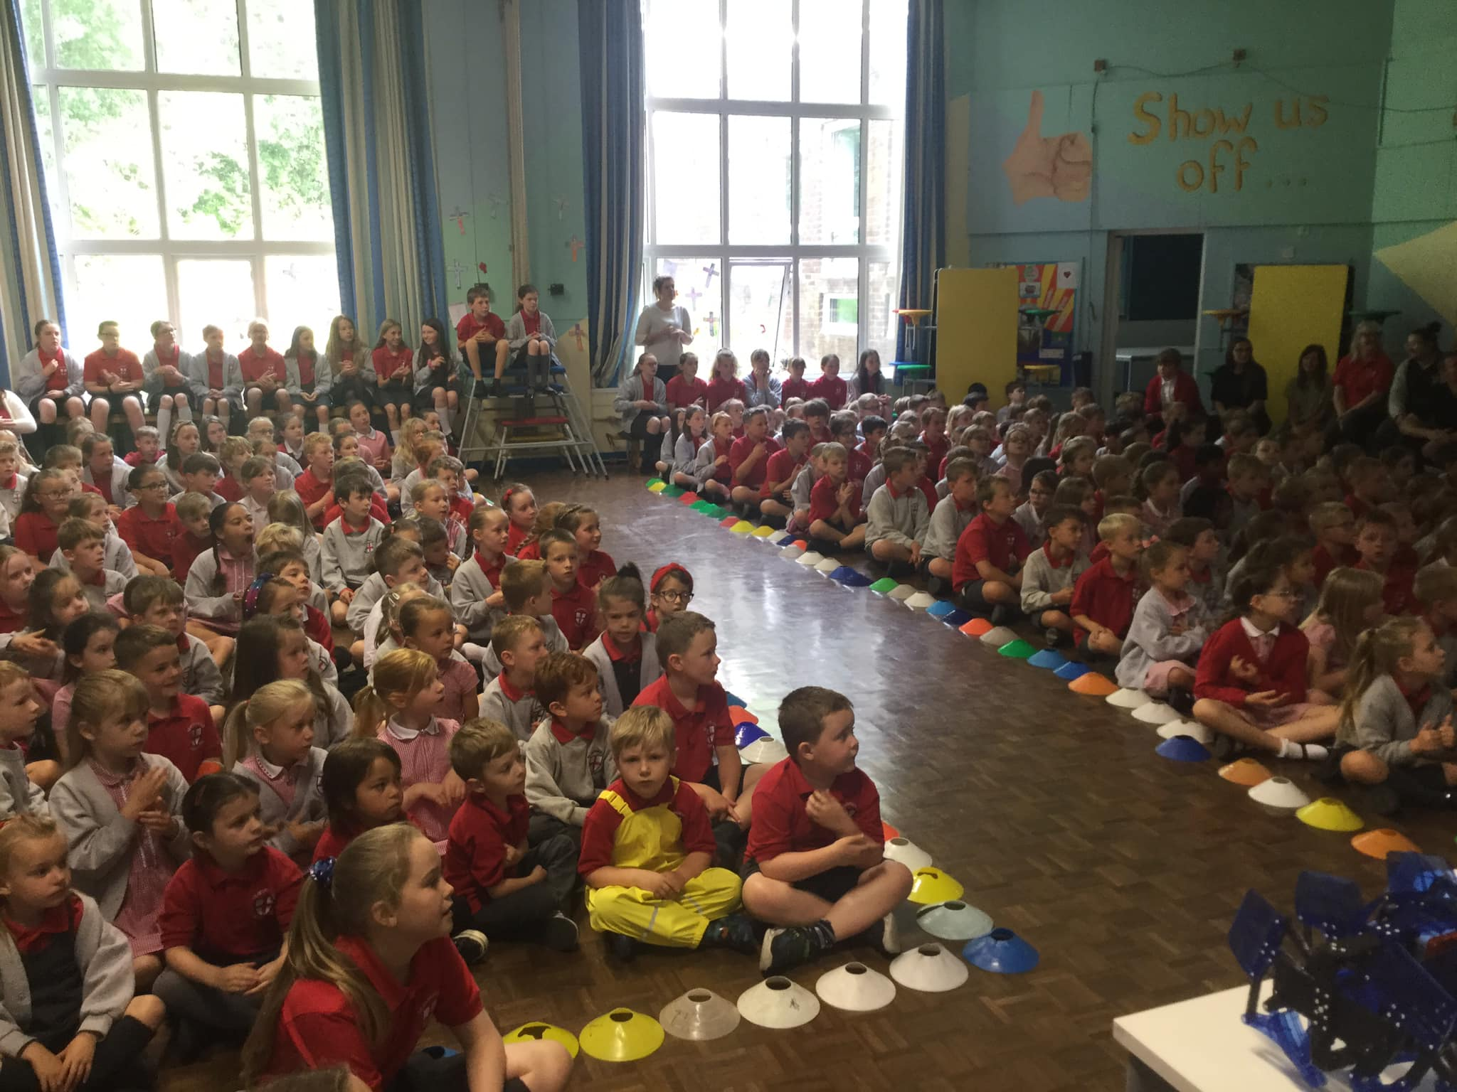
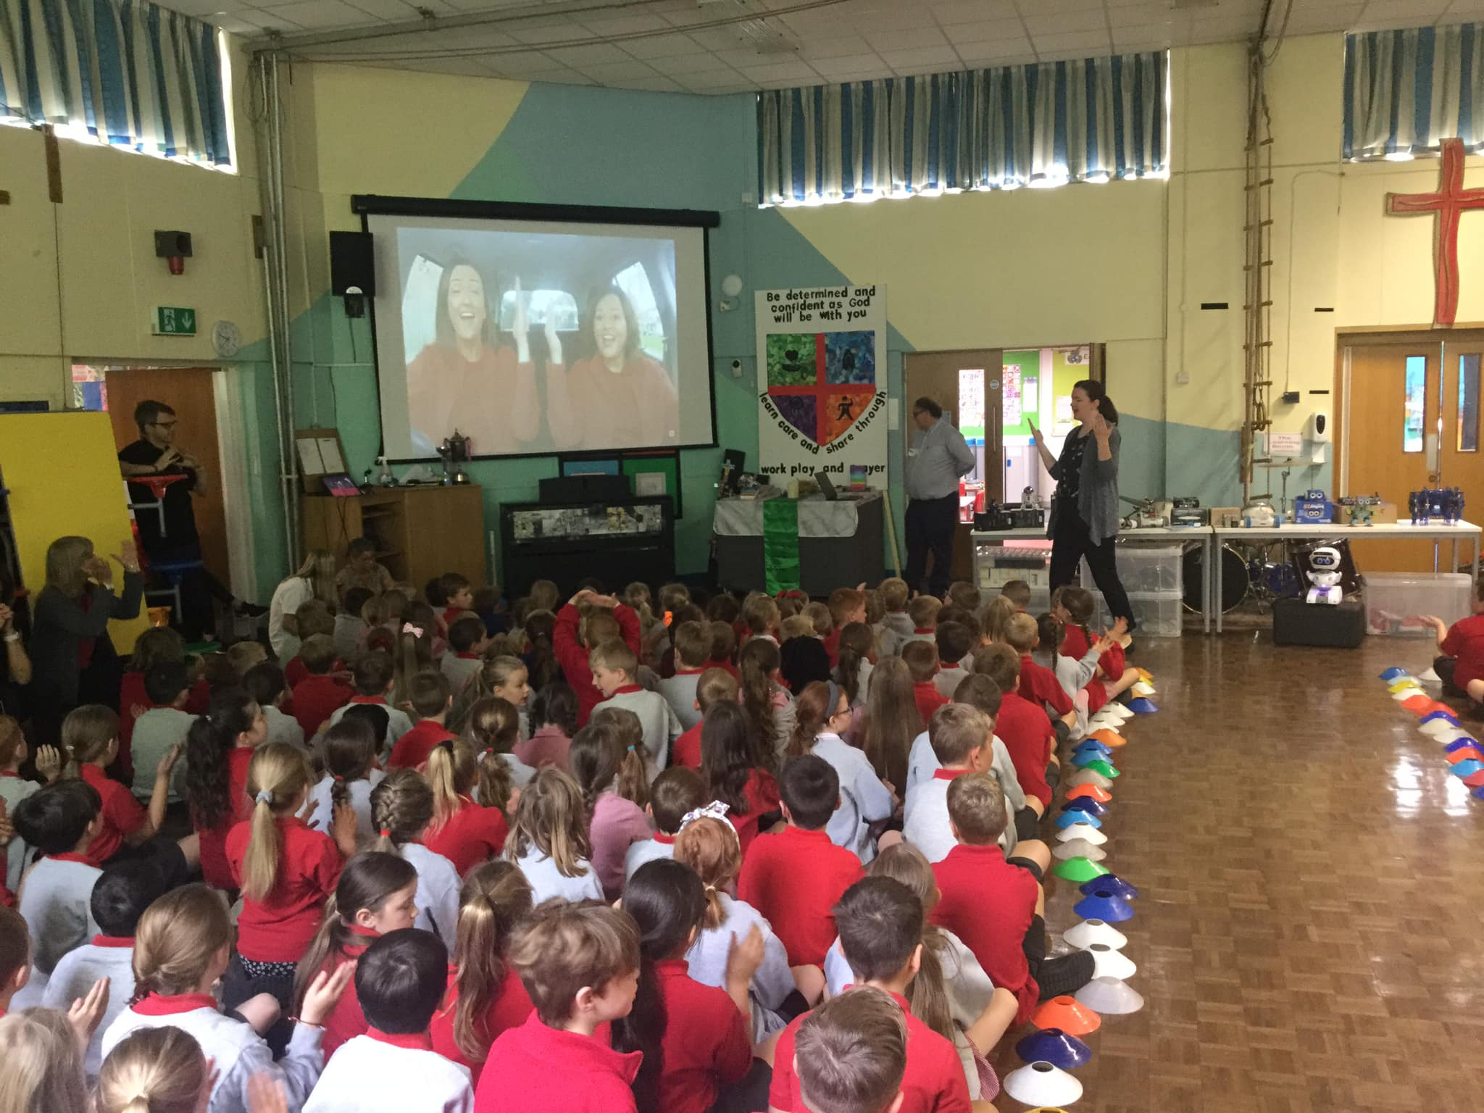
STEM Week
Science, Technology, Engineering
and Mathematics.
The whole school enjoyed a fantastic, robot inspired week to explore environmental issues and the care of our planet. The following slides show just a selection from a very busy week!
Class 7 came to visit and shared their very entertaining alternative endings to ‘Elephant in my kitchen’. We then designed our own tri-part animals together and had lots of fun naming them and describing their habitat.​
June 2022

Slide 9
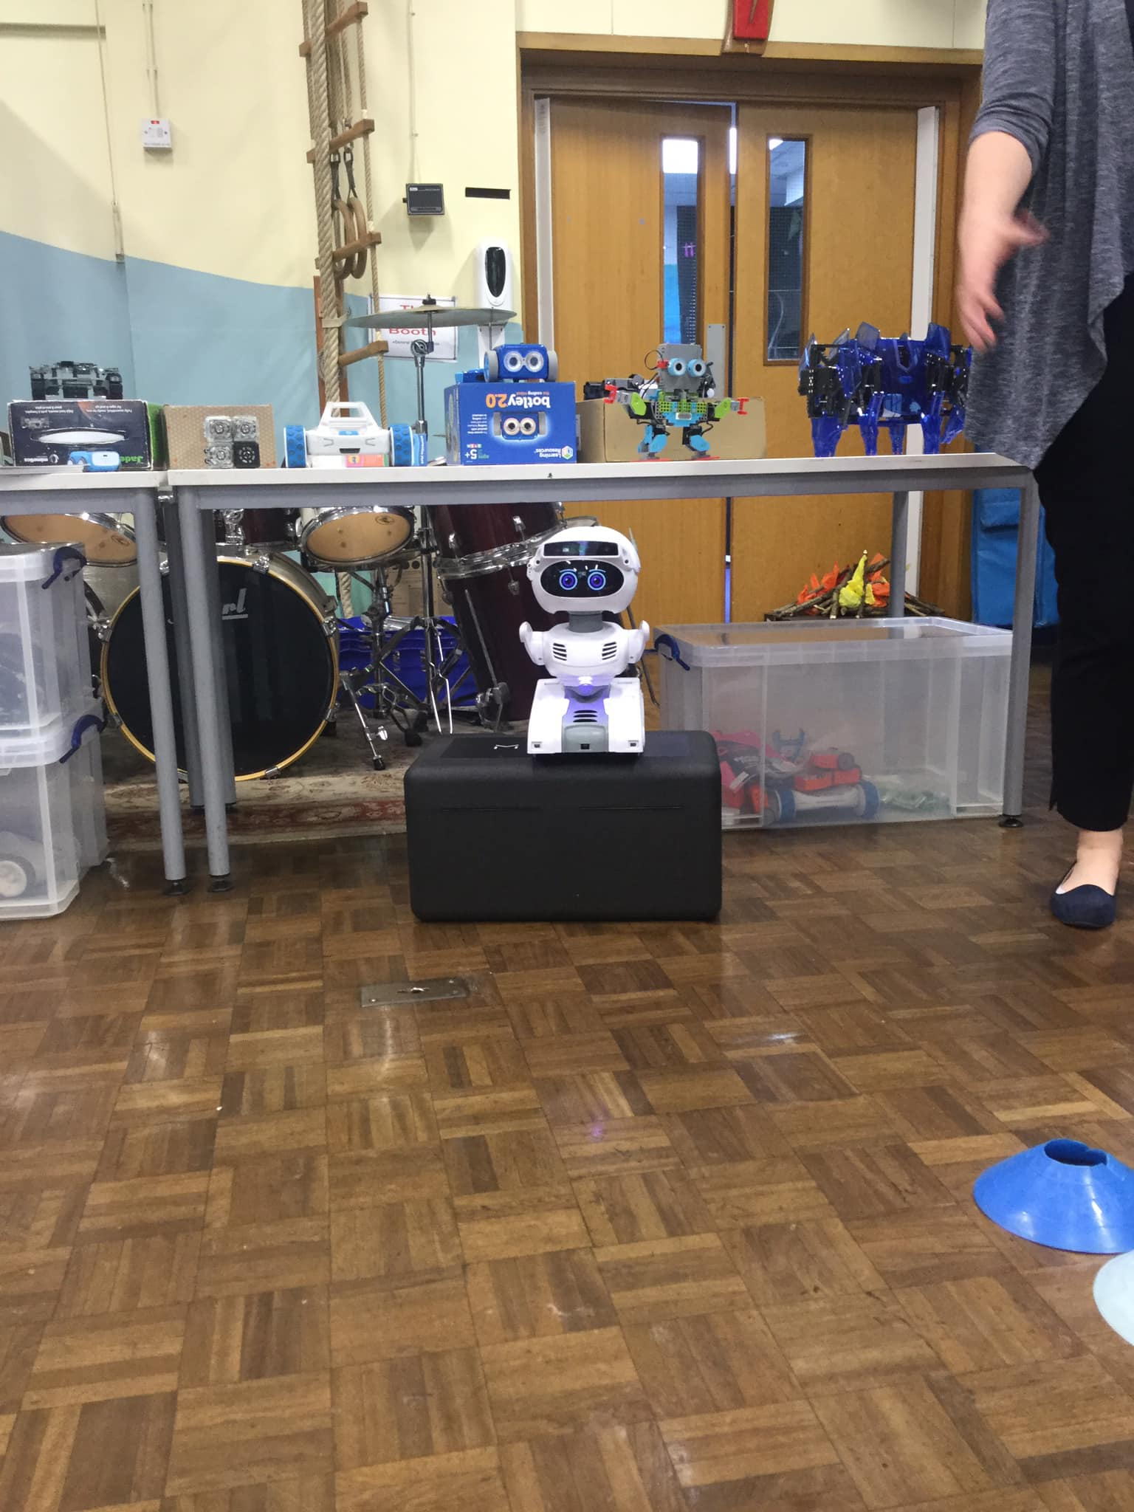
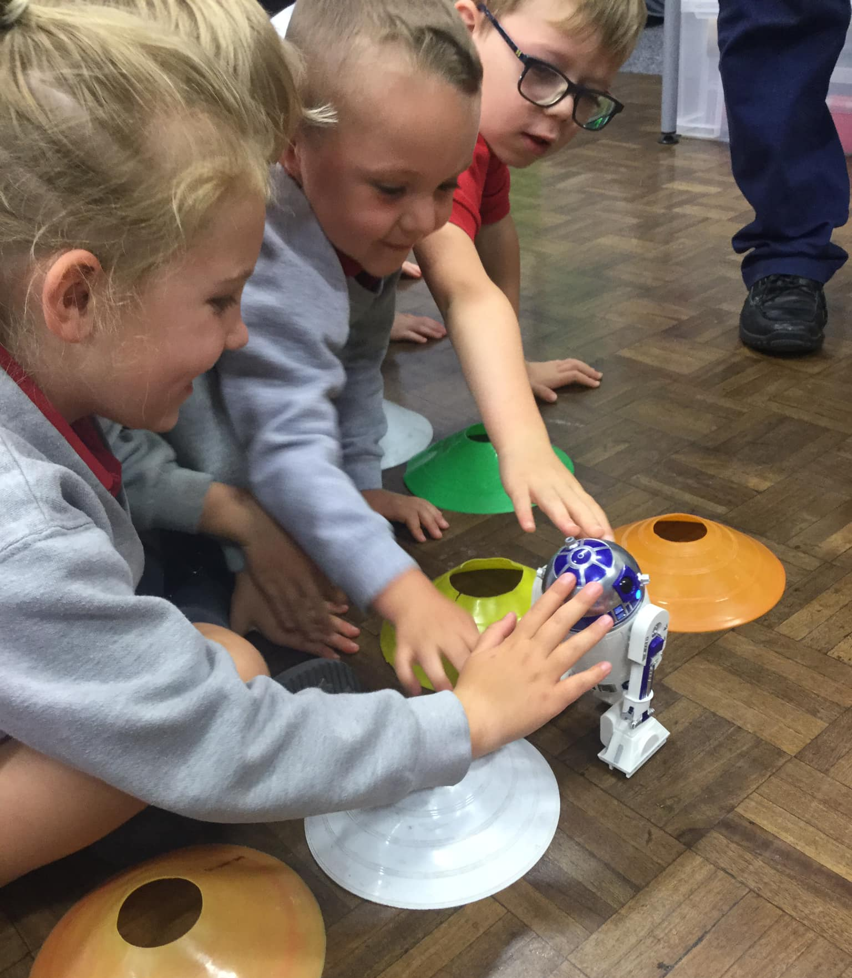
STEM Week
What an exciting start to STEM week. Misty the robot visited us from the future and warned us that we need to look after our planet. She brought some of her friends and cousins along too!
July 2022

Slide 10
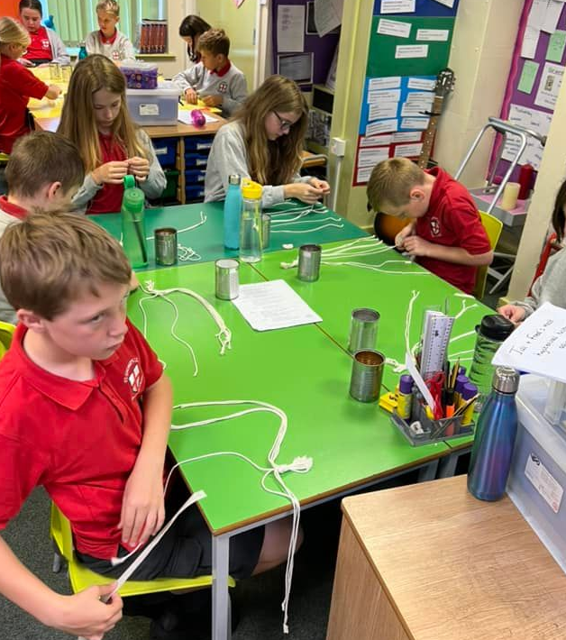
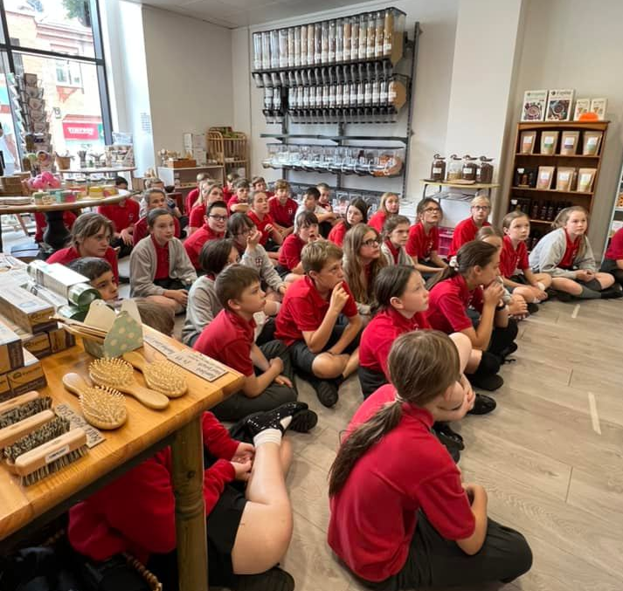
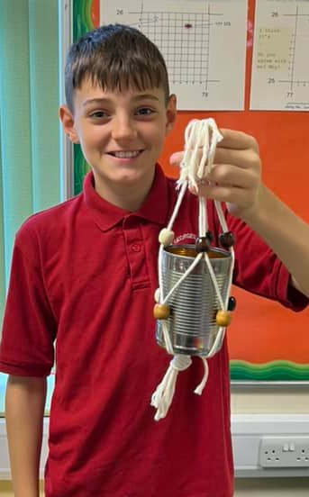
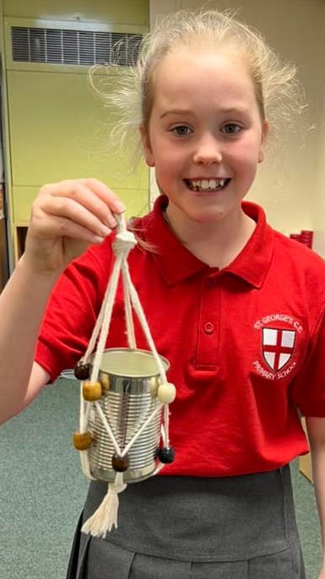
Stem Week
Year 6 upcycled tin cans and made their own hanging baskets.
They also visited Reeds Refillery in Chorley where they learnt all about reducing plastic use when shopping.
June 2022

Slide 11
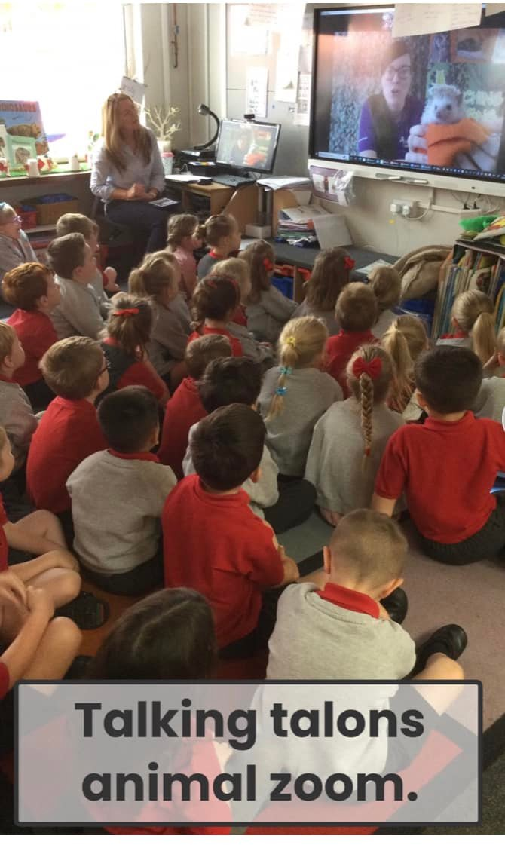
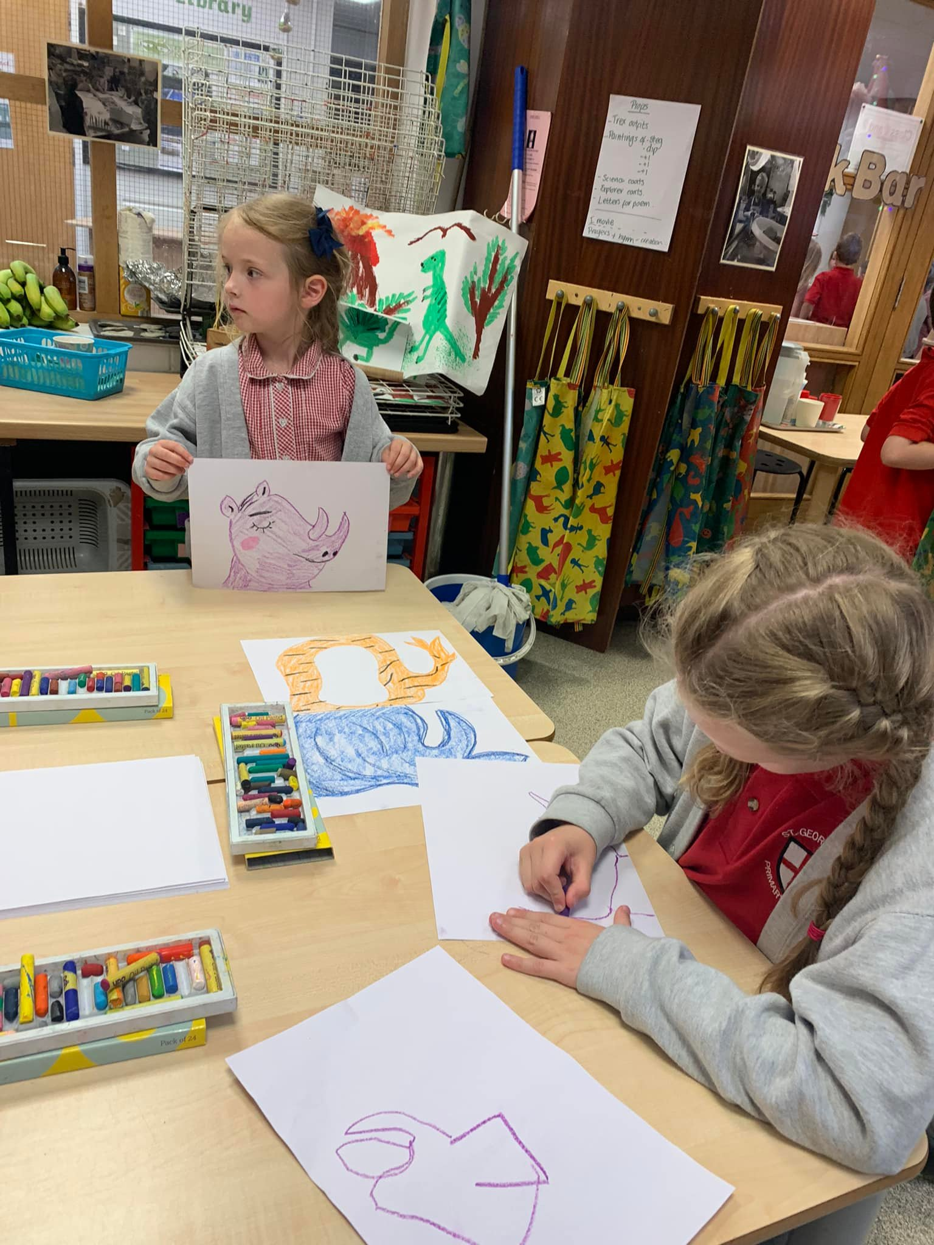
STEM Week
Reception had a Zoom session with Becky from Teaching Talons who showed us Quillium the African hedgehog, Norbert the bearded dragon and Pigwigeon the owl.
Class 7 came to visit and shared their very entertaining alternative endings to ‘Elephant in my kitchen’. We then designed our own tri-part animals together and had lots of fun naming them and describing their habitat.​
June 2022

Slide 12
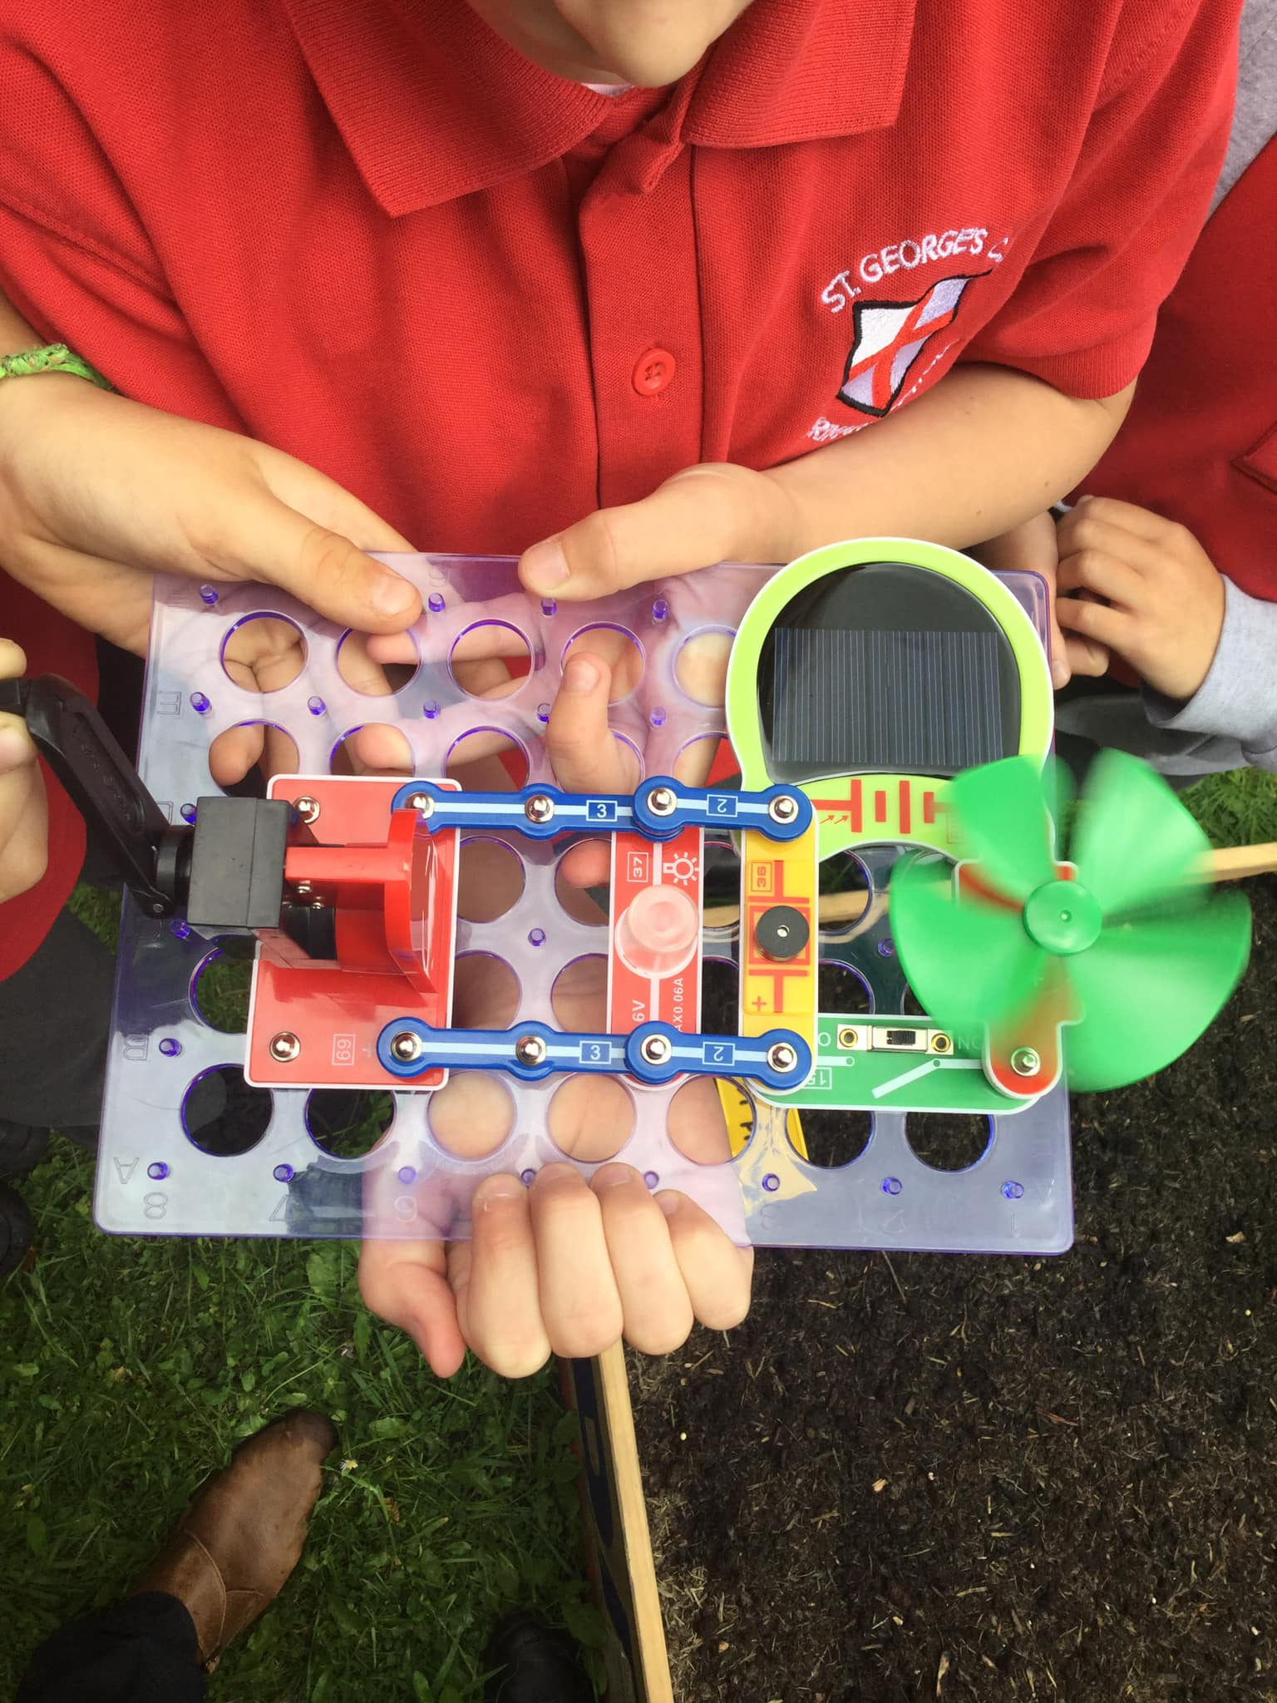
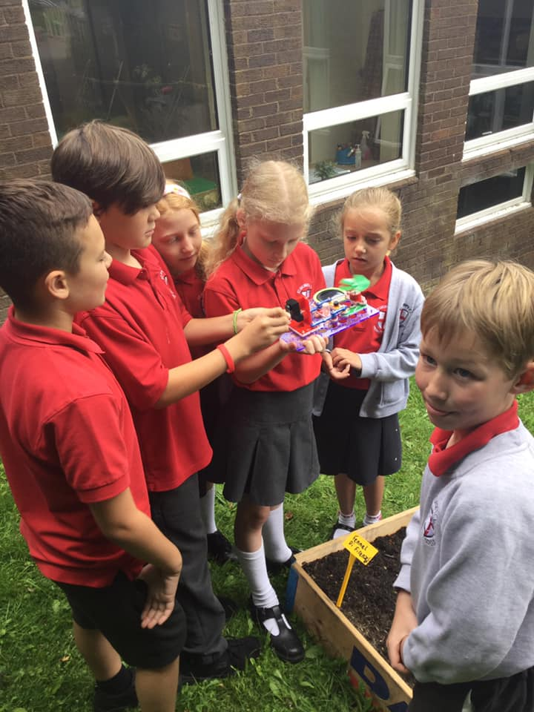
STEM Week
Class 8 investigated renewable energy. They researched the scientist, Maria Telkes, who was known as ‘The Sun Queen,' and then investigated the different types of renewable energy.
June/July 2022

Slide 13
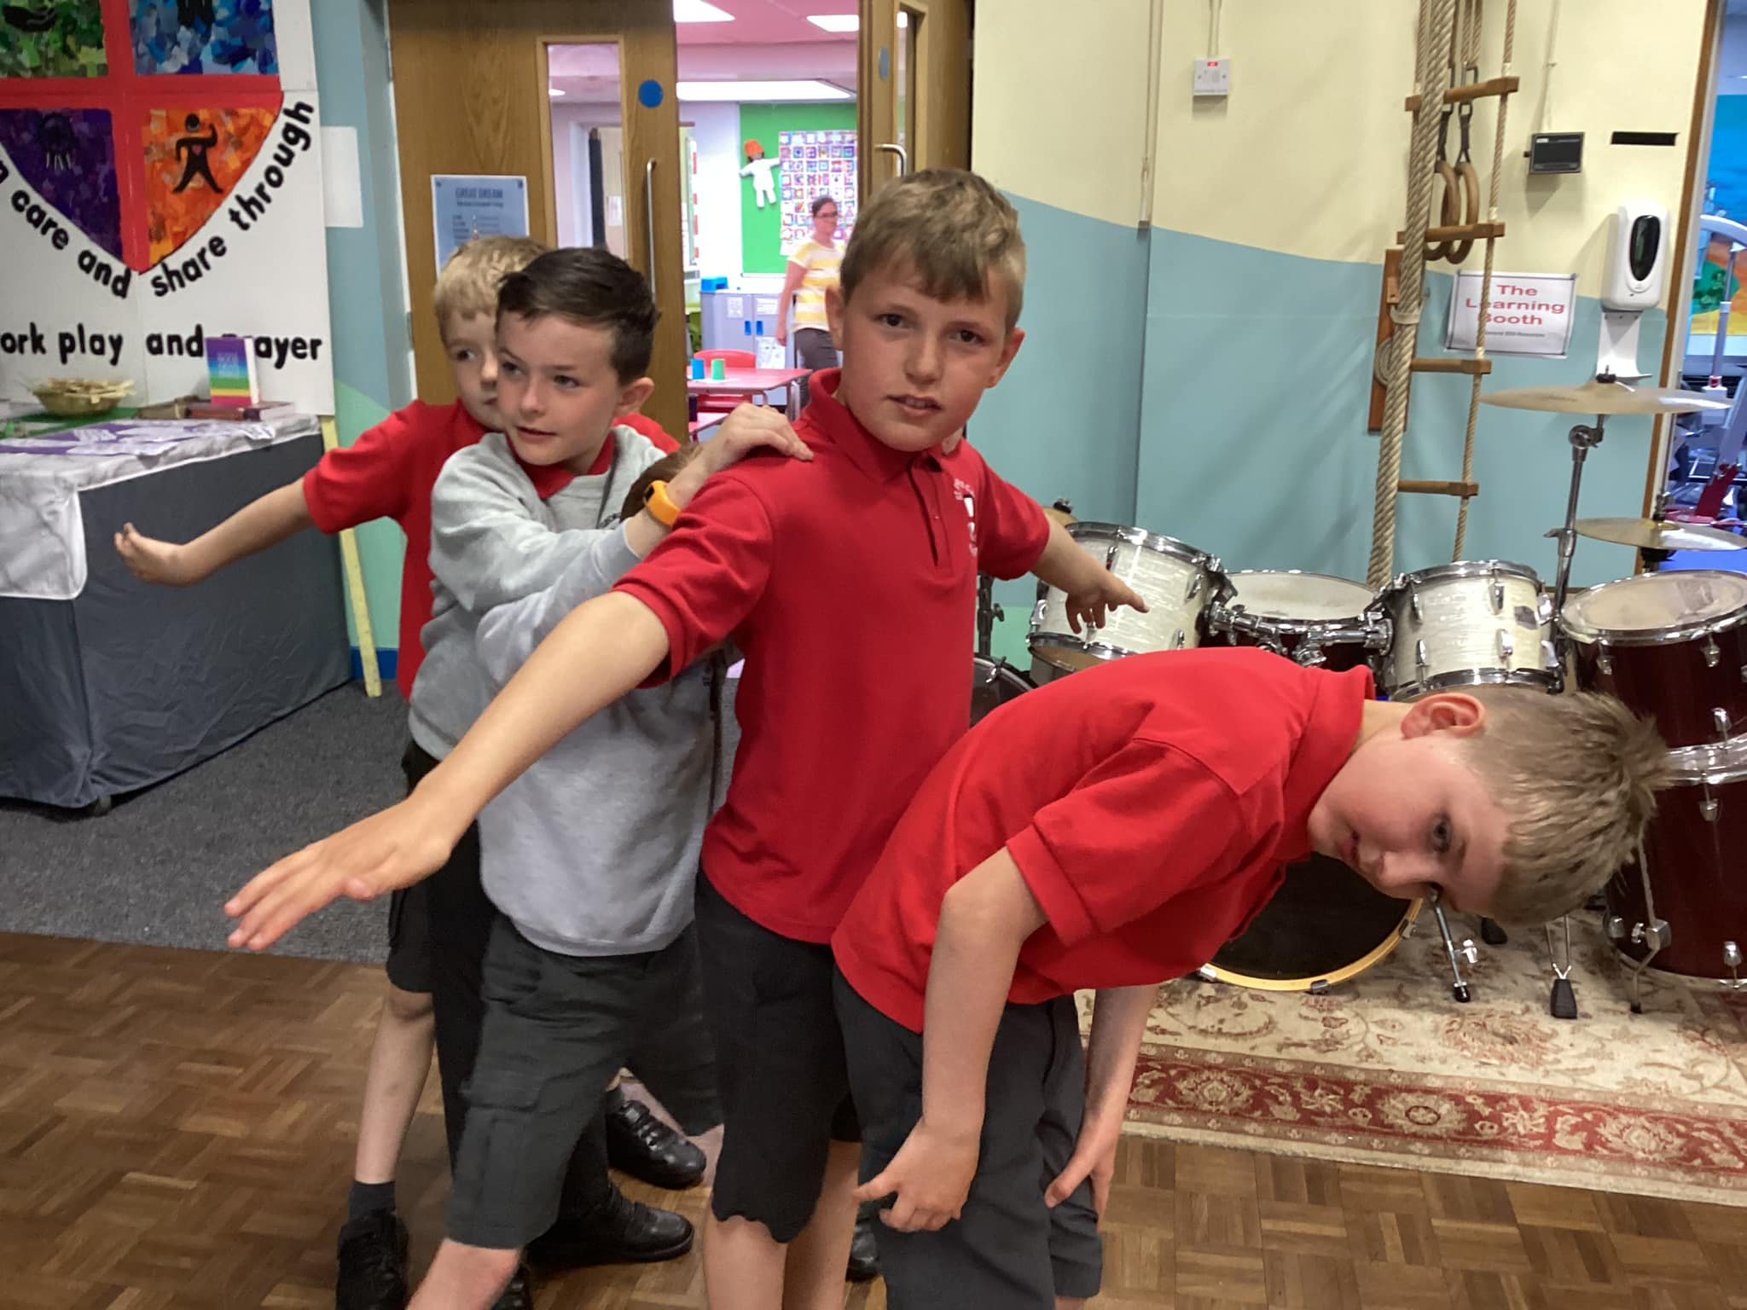
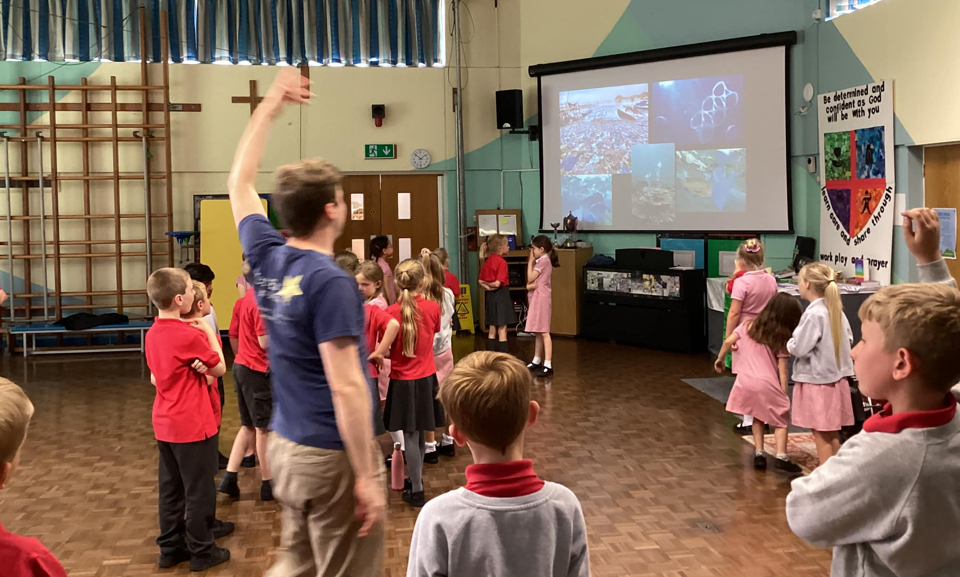
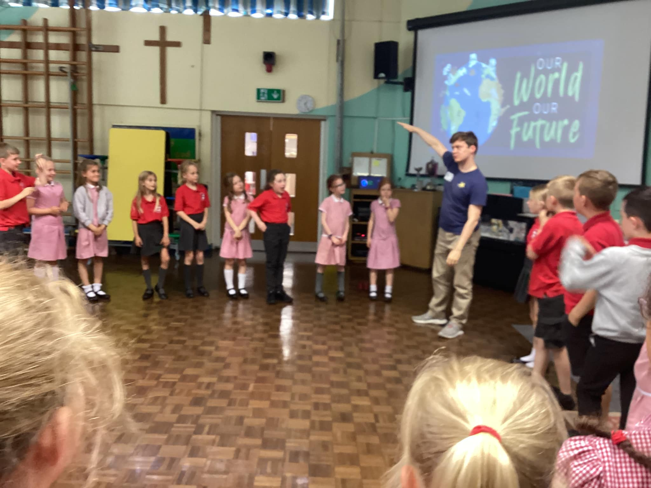
STEM Week
Class 6 took part in a Drama class to explore fossil fuels and carbon gasses. They watched a clip from David Attenborough and wrote to tell him about the work we have done on sustainability and becoming more eco friendly.
June 2022

Slide 14
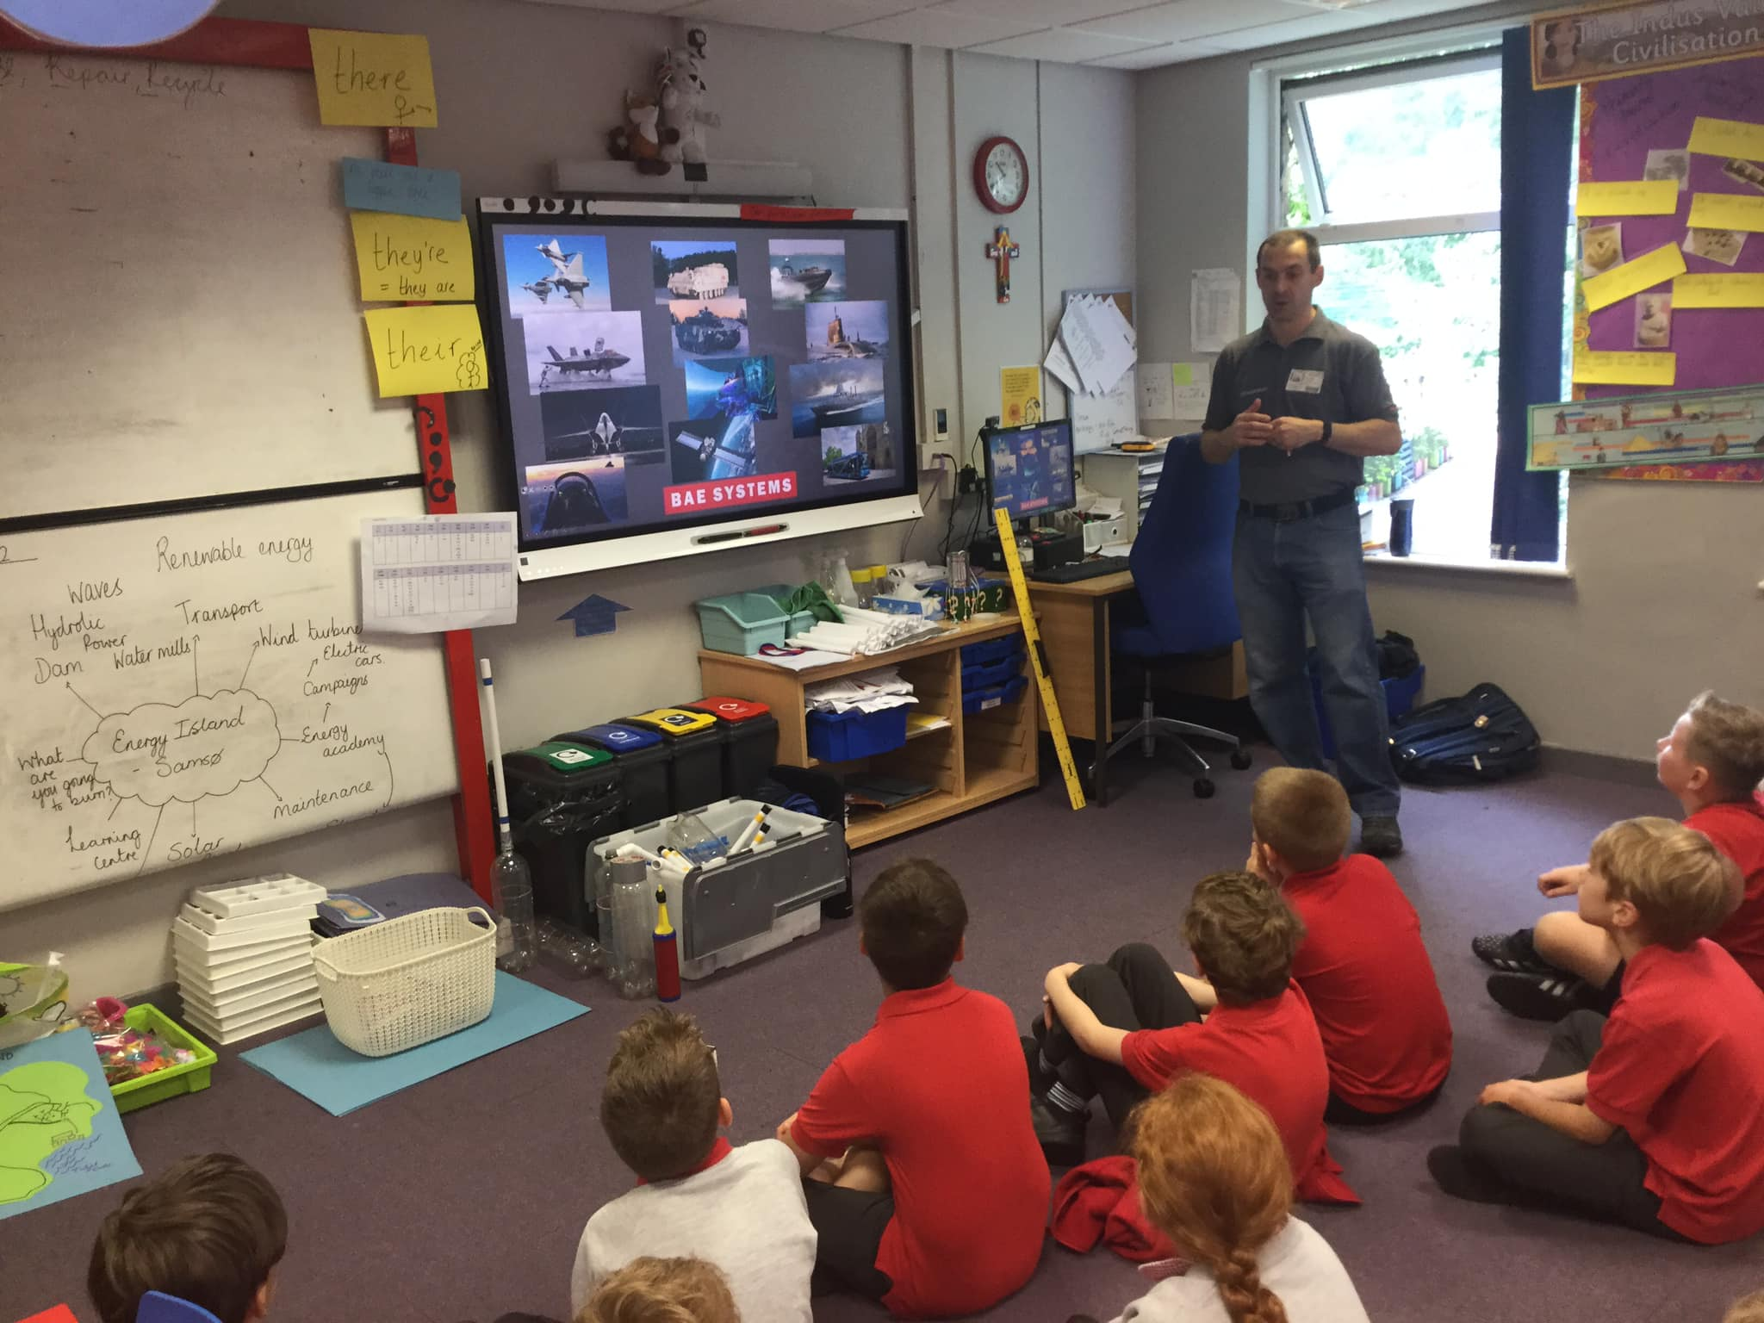
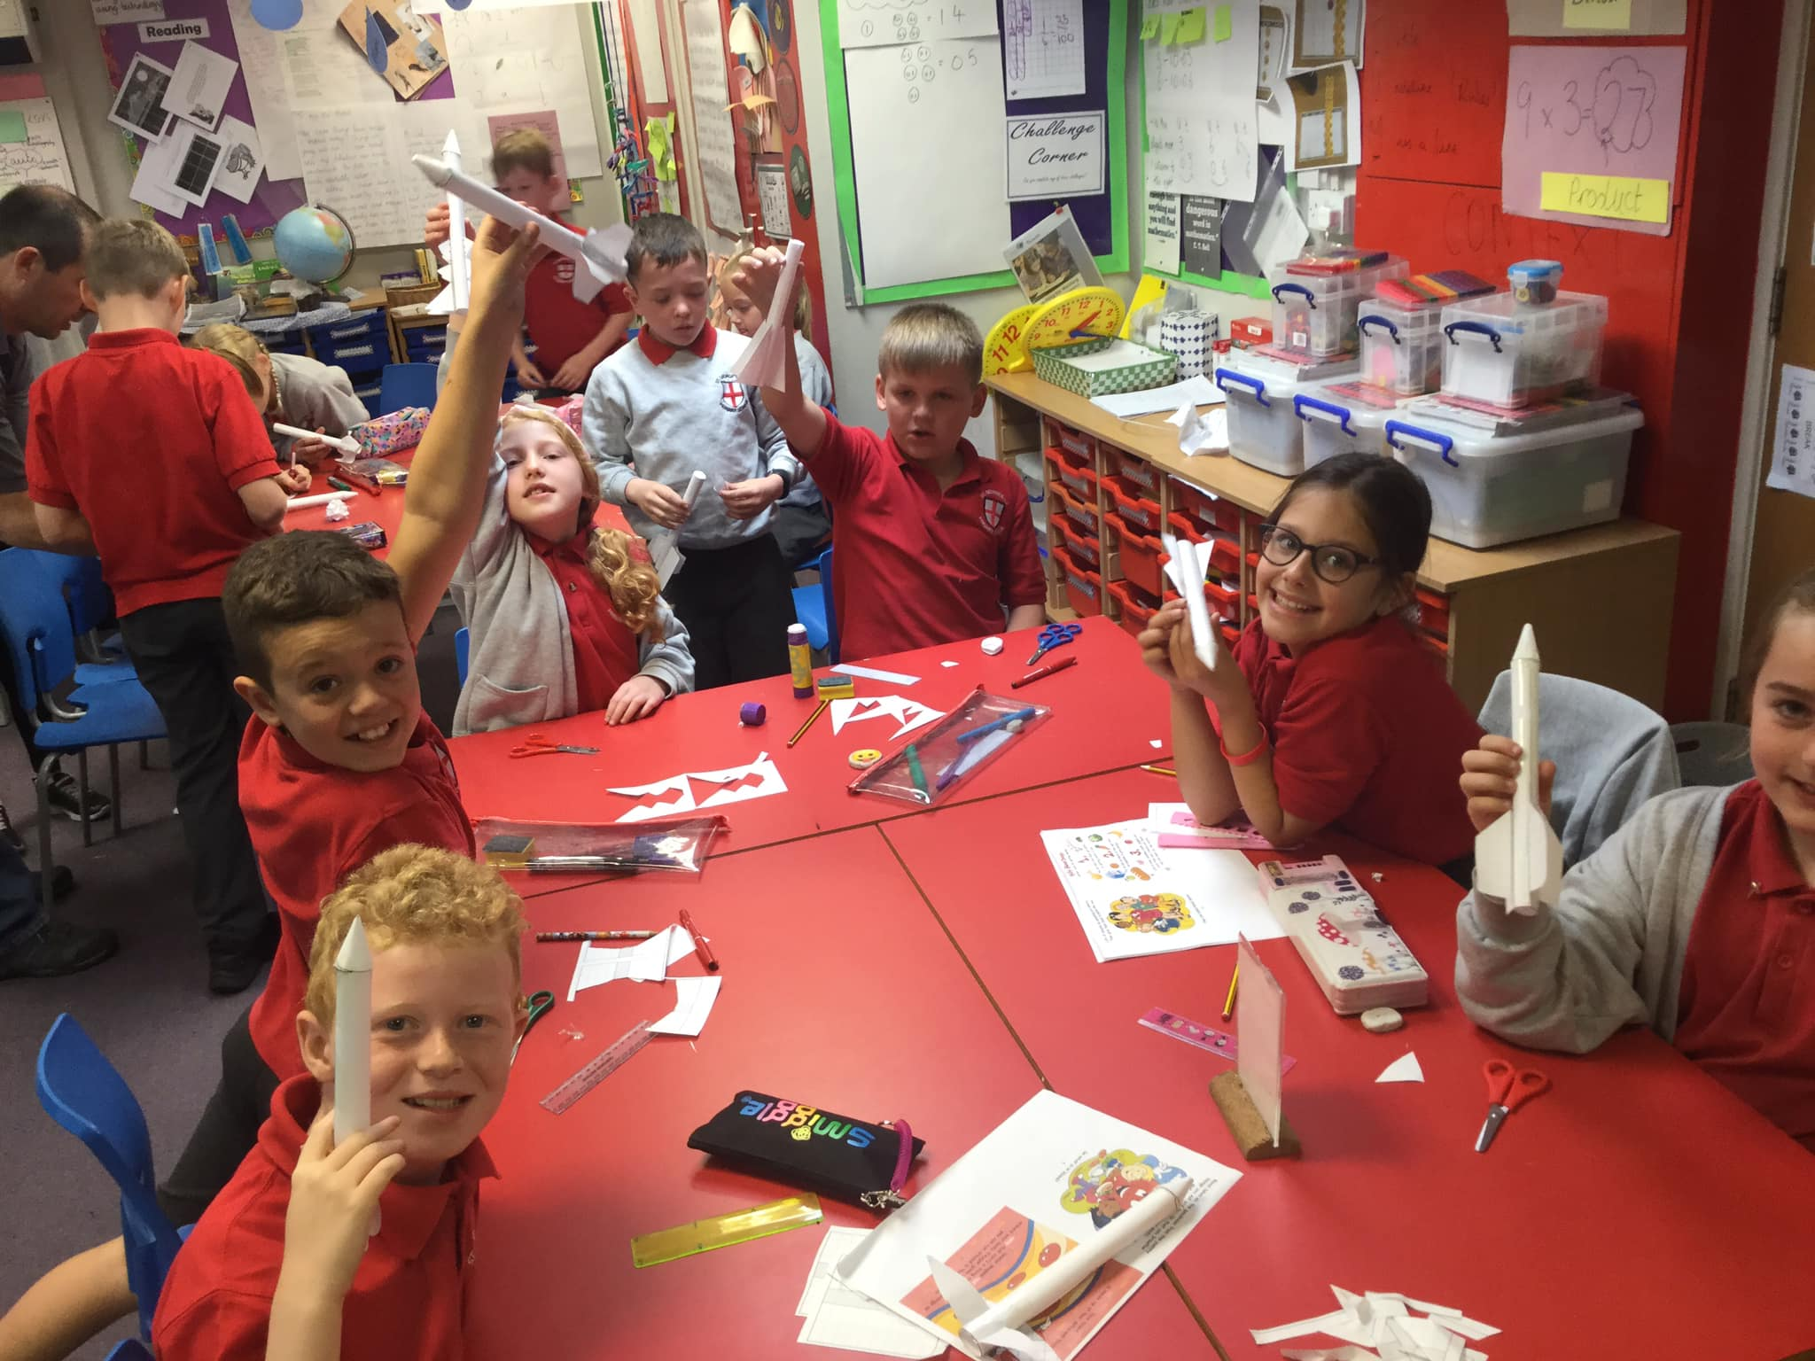
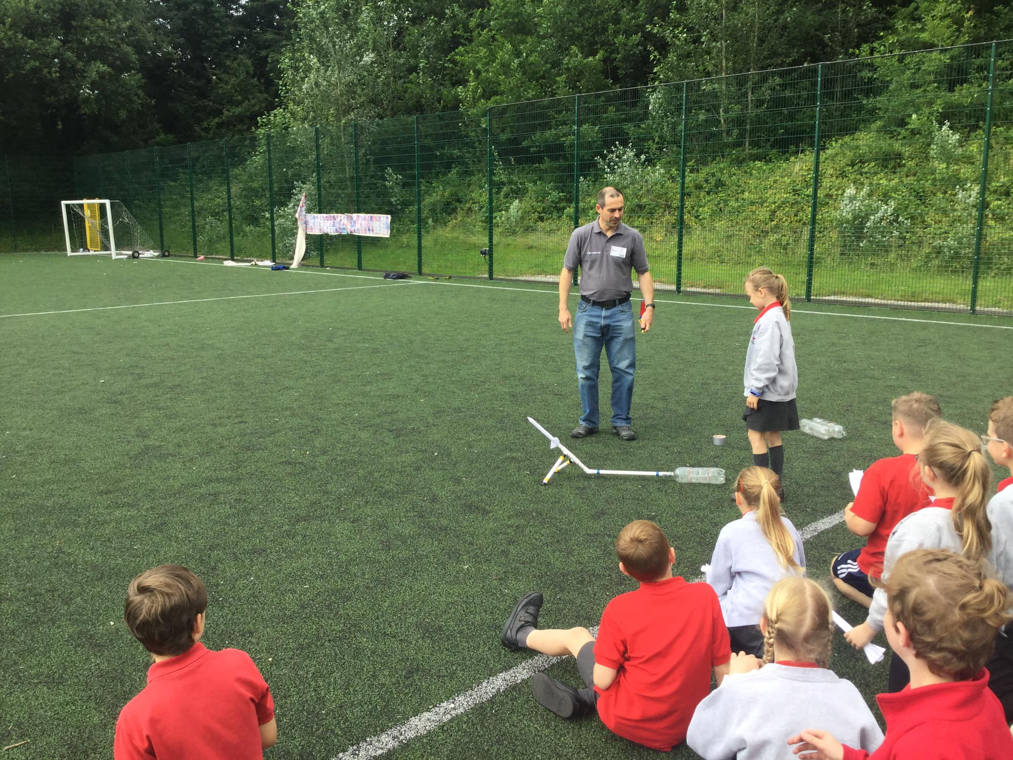
STEM Week
Class 8 had a visitor from BAE who helped us design and test rockets, and the shape and size of their fins.
June 2022

